Slide 1
2025 California Mechanical Code
Part 4

Slide 2
CHAPTER 2 DEFINITIONS
203.0 – A –
Air Terminal Device. [OSHPD 1, 2, 3, 4 and 5] Any device (e.g., grille, register, diffuser) placed in an opening to a room, through which controlled air enters or leaves. Component of the air-distribution system which has the purpose of achieving the predetermined movement of air into or from a treated space.
Notes:
Definition added to coordinate with HEPA filtration requirements in Section 408 and Table 4-B. Definition based on ASHRAE terminology.

Slide 3

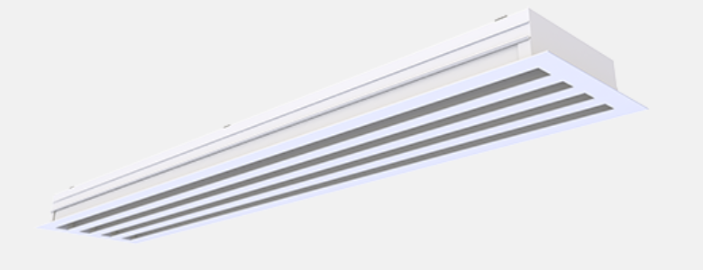
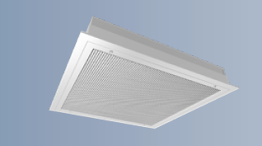
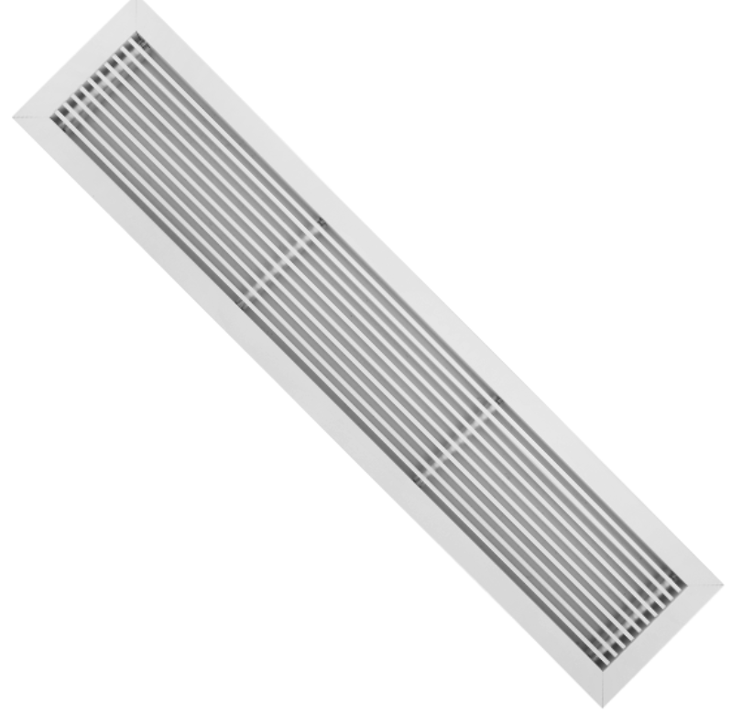
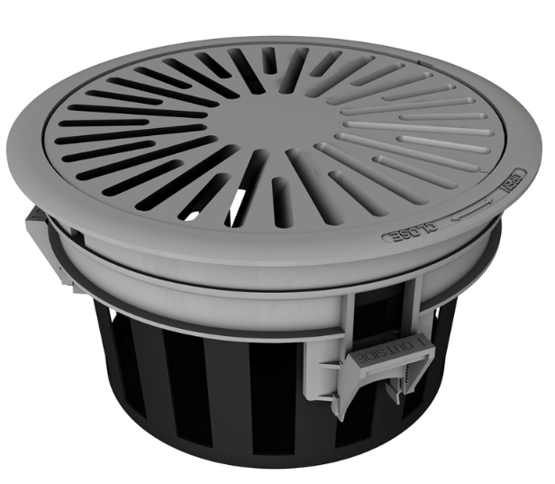
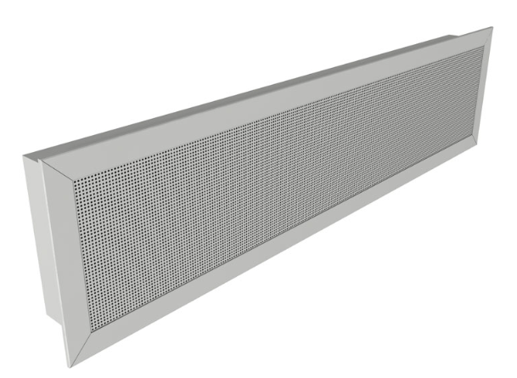
Air Terminal Devices – Outlet types
Group A: Mounted in or near the ceiling, projecting air horizontally (e.g., Square Plaque Diffuser)
Group B: Mounted in or near the floor, projecting air vertically in a linear jet (e.g., floor-mounted Linear Bar Grille)
Group C: Mounted in or near the floor, projecting air vertically in a spreading jet (e.g., Modular Floor Diffuser with a twist pattern)
Group D: Mounted in or near the floor, projecting air horizontally (e.g., Displacement Flow Diffuser)
Group E: Mounted in or near the ceiling, projecting air vertically downward (e.g., Linear Slot Diffuser, non-aspirating)
Group A
Group E
Group E, non-aspirating
Group B
Group C
Group D

Slide 4
CHAPTER 3 GENERAL REGULATIONS
321.0 Essential Mechanical Provisions. [OSHPD 1, 1R, 2, 3 (Surgical Clinics only) 4 & 5] During periods of power outages essential electrical power shall be provided for the following equipment:
321.3 Cooling equipment necessary to maintain temperature and humidity listed in Table 4-A for a minimum of one operating room and other spaces as identified in the functional program.
321.5 6 All control components, and control systems and fire and smoke dampers necessary for the normal operation of equipment required to have essential electrical power.
*321.2 intended for Acute Care Facilities that are required to remain functional during a loss of normal power.
Notes:
Cooling for a minimum of one operating room and other areas identified in the functional program is added. This requirement was developed while working with CDPH with NPC 5 requirements.
Fire and smoke dampers was added to the list of control components required to be provided with essential power to keep the ventilation operating.

Slide 5
Generator Exhaust
324.0 Diesel-Powered Emergency Generators. [OSHPD 1, 1R, 2, 3, 4 & 5]
The minimum horizontal separation distance between diesel-powered emergency electrical generator exhaust outlets and operable doors, windows and intake openings shall be 30 feet. The minimum horizontal distance from the generator exhaust to a property line shall be 15 feet (4.57 m) or per the requirements of the local AHJ, whichever is greater.

Slide 6
CHAPTER 3 GENERAL REGULATIONS
322.0 Sensitive Areas or Rooms. [OSHPD 1, 1R, 2, 3 (Surgical Clinics) 4 & 5] The following are sensitive areas or rooms:
(1) Operating room, hybrid operating room
(2) Hybrid operating room
(3) Cesarean operating room
(4) Delivery room,cesaren operating room
(5) Surgical Cystoscopy
(6) Class 3 imaging
(7) Cardiac catheterization lab
(8) Trauma/cardiac room
(9) Post-anesthesia care unit
(10) Intensive care
(11) Newborn intensive-care nursery unit
(12) Newborn nursery
(13) Burn unit
(14) Protective Environment Room
(15) Procedure room
(16) Class 2 imaging
(17) Gastrointestinal endoscopy procedure room
Notes:
List of Sensitive spaces that require humidity control was revised to provide a single room type per item. Also picked up similar room types in CBC Section 1224. Class 2 imaging and procedure added to list.

Slide 7
SNF Alternate Power (OSHPD 2)
325.0 Alternate Source of Power for Safe Temperatures. [OSHPD 2]
Mechanical equipment required to maintain a safe temperature for residents shall be powered by an alternate source of power per California Electrical Code Section 517.1. The safe temperature shall be between 71- 81°F.
See OSHPD PIN 74 and the A6 Advisory Guide relating to alternate power for skilled nursing facilities

Slide 8
CHAPTER 4 VENTILATION AIR
402.0 Ventilation Air.
402.1 Occupiable Spaces. Occupiable spaces listed in Table 402.1 [OSHPD 1, 1R, 2, 3, 4 & 5] and Table 4-A shall be designed to have ventilation (outdoor) air for occupants in accordance with this chapter. [DSA-SS & DSA-SS/CC] Ventilation air requirements for occupancies regulated by the California Energy Commission are found in the California Energy Code.
[CEC] Ventilation air requirements for occupancies regulated by the California Energy Commission and found in the California Energy Code supersede those of the California Mechanical Code.
[OSHPD 1, 2, 3, 4 & 5] Health care spaces shall meet the ventilation requirements found in Table 4-A. (relocated from 402.1.2)Ventilation rates for areas not specified in Table 4-A shall have minimum ventilation and air change rates per ANSI/ASHRAE Standard 62.1. Where areas with prescribed ventilation rates in both Standards 62.1 and Table 4-A exist, the higher of the two air change rates shall be used.
Notes:
OSHPD amendment calling out Table 4-A moved to separate paragraph. Additional ventilation requirements from 402.1.2 included in amendment relating to ASHRAE 62.1 for spaces not under Table 4-A.

Slide 9
CHAPTER 4 VENTILATION AIR
402.1.2 Ventilation in Health Care Facilities. Mechanical ventilation for health care facilities shall be designed and installed in accordance with this code and ASHRAE 170, and NFPA 99. [OSHPD 1, 1R, 2, 3, 4 & 5] Ventilation for health care facilities shall be designed and installed in accordance with this code and Table 4-A.-2013, through Addendum ae. (relocate to 402.1) Ventilation rates for areas not specified in Table 4-A shall have minimum ventilation and air change rates per ANSI/ASHRAE Standard 62.1.Where areas with prescribed ventilation rates in both Standards 62.1 and Table 4-A exist, the higher of the two air change rates shall be used. All supply-air, return air, and exhaust-air systems shall comply with this code and ASHRAE 170. When the requirements of this code conflict with ASHRAE 170, the most restrictive requirements shall prevail. The text of ASHRAE 170 shall be modified as follows:
Notes:
The UMC adopts the 2021 edition of ASHRAE 170. OSHPD amendment revised as the 2013 addendum through ae is no longer applicable.
OSHPD amendments in Chapter 4 revised to align with the 2021 edition of ASHRAE 170.
Stricken out language was moved to Section 402.1.1 shown in previous slide.\
Second to last sentence added to clarify requirements between ASHRAE 170 and OSHPD amendments. ASHRAE 170 is adopted by model code. OSHPD amendments do not address all items in 170. The BSU is working to align the existing OSHPD amendments with ASHRAE 170, btu some conflicts may arise.

Slide 10
CHAPTER 4 VENTILATION AIR
406.0 Evaporative Cooling System for Health Care Facilities. [For OSHPD 1, 1R, 2, 3, 4 & 5] Direct evaporative cooling systems where the air directly contacts the wetted surface or spray shall be limited in health facilities to nonpatient areas such as laundry rooms, food preparation areas, and boiler or machinery rooms. Similar rooms with high heating-producing equipment will be considered when specifically approved by the enforcing agency. The evaporative pads shall be a synthetic type. Filters shall be required in accordance with Tables 4-B and 4-C except utility rooms, i.e.: boiler or machinery rooms.
Notes:
Section 406 is removing the amendment for OSHPD 1R. Food preparation is also being removed from the section. Food preparation is included in Table 4-A and 170 and is not a dirty room as the other room types in this section.

Slide 11
Exhaust Systems
407.1.2 Fans serving exhaust systems shall be located at the discharge end of the system. Ductwork within the building shall be under negative pressure. The ventilation rates shown in Table 4-A shall be considered as minimum acceptable rates and shall not be construed as precluding the use of higher ventilation rates if they are required to meet design conditions.

Slide 12
CHAPTER 4 VENTILATION AIR
407.2.2 Exhaust Outlets. Exhaust outlets shall be located a minimum of 10 feet (3048 mm) above adjoining grade and 10 feet (3048 mm) from doors, occupied areas, and operable windows.
Exception: Airborne infection isolation rooms shall comply with Section 414.1.
407.2.2.1 Hazardous Exhaust Outlets. Hazardous exhaust outlets from airborne infection isolation rooms, bronchoscopy and sputum collection exhaust, hazardous drug compounding, morgues, autopsy rooms and laboratory chemical fume hoods shall discharge a minimum of 10 feet (3048 mm) above the adjacent roof surface and a minimum of 30 feet (9144.mm) from outdoor air intakes, building openings and areas normally accessible to the public.
Notes:
Section 407.2.2.1 is added to bring in the requirement for exhaust height discharge for specific spaces of infection control in accordance with ASHRAE 170.

Slide 13
CHAPTER 4 VENTILATION AIR
407.3 Air Balance.
407.3.1 The ventilation systems shall be designed and balanced to provide the general air balance relationship to adjacent areas, shown in Table 4-A. The ventilation systems shall be balanced in accordance with the latest edition of standards published by the Associated Air Balance Council (AABC), the National Environmental Balancing Bureau (NEBB), or the Testing, Adjusting and Balancing Bureau (TABB). Air balance tolerancing values shall not result in noncompliance of the minimum required pressurization per Table 4-A.
Notes:
A new sentence is being added to clarify air flow values must still provide the minimum required pressurization when balancing. Some air balance tolerances can be 10%. Where an air flow value can be within 10% and be within tolerances of the approved plans, the required pressure differentials must also be provided.

Slide 14
CHAPTER 4 VENTILATION AIR
407.4 Air Circulation.
407.4.1 Design of the ventilation system shall provide air movement that is generally from clean to less clean areas.
407.4.1.1 (formerly 420.0) 420.0 Air Distribution Devices [OSHPD 1, 2, 3, 4, 5] All air distribution devices and supply air outlets shall meet the requirements of ASHRAE 170-2013, Section 6.7.2 and Table 6.7.2 6-2.
407.4.1.2 (formerly 407.4.1.6) Supply outlets and return and exhaust air inlets shall be located to prevent short-circuiting.
407.4.1.3 (formerly 407.4.1.1) Air supplied to operating rooms, cesarean operating rooms, cardiac catheterization labs, surgical cystoscopy rooms, delivery rooms, and class 3 imaging shall be delivered by a primary supply diffuser array in accordance with ASHRAE 170, 7.4.1.at the ceiling of the area served. In these areas and in morgues and autopsy rooms all air removed from the area shall be removed near floor level. Exhaust or recirculation inlets shall be located not less than 3 inches (76 mm) nor more than 8 inches (203 mm) above the finished floor, except in morgues and autopsy rooms where all of the exhaust air is removed through an autopsy table designed for this purpose. At least two exhaust or recirculation air inlets of equal capacity shall be used in all cardiac catheterization labs, cystoscopy rooms, operating rooms, and delivery rooms and shall be located not less than 3 inches (76 mm) nor more than 8 inches (203 mm) above the finished floor.
Notes:
Section 407.4 was revised to clarify the requirements. Section 420 pointing to the ASHRAE 170 requirements for air distribution devices was moved into Section 407.4.1.1
The supply outlet short circuiting requirement is a general requirement for all locations and was moved to 407.4.1.2.
407.4.1.1 was moved and split into Sections 407.4.1.3-407.4.1.6. The large paragraph included supply and return/exhaust requirements for operating and morgues. The clean operating room requirements were located together and the morgue and autopsy requirements were put into a separate sub section.

Slide 15
CHAPTER 4 VENTILATION AIR
407.4.1.4 Air supplied to procedure rooms and Class 2 imaging shall be delivered over the patient table. Return or exhaust inlets shall be located at the perimeter of the room on a minimum of two sides to provide air movement from clean to less clean.
407.4.1.5 At least two exhaust or recirculation air inlets of equal capacity shall be provided on opposite corners in all operating rooms, cesarean operating rooms, cardiac catheterization labs, surgical cystoscopy rooms, delivery rooms and class 3 imaging. All air inlets in the room shall be located not less than 3 inches (76 mm) nor more than 8 inches (203 mm) above the finished floor.
407.4.1.6 Morgues and autopsy rooms shall exhaust air through an autopsy table designed for this purpose or through low sidewall exhaust inlets located not less than 3 inches nor more than 8 inches (203 mm) above the finished floor.
407.4.1.7 (formerly 407.4.1.2) Room supply air outlets and room recirculation and exhaust air inlets installed in nonsensitive areas shall be located not less than 3 inches (76 mm) above the floor.
Exception: For airborne infection isolation rooms and protective environment rooms, see Sections 414.0 and 415.0.
Notes:
407.4.1.4 is a new section to provide the directional airflow for class 2 imaging and procedure rooms for clean to less clean.
407.4.1.5 locates the return/exhaust inlet requirements for operating room type spaces.
407.4.1.6 picks up the morgue and autopsy requirements.
407.4.1.7 is the relocated 407.4.1.2 section for position of low inlets.

Slide 16
CHAPTER 4 VENTILATION AIR
407.4.1.3 407.4.2 Corridors shall not be used to convey supply, return, transfer or exhaust air to or from any room if the corridor is required to be fire resistive construction per the California Building Code.
Exceptions:
(1) Mechanically exhausted toilet rooms of 50 square feet (4.7 m2) or less and small rooms of 30 square feet (2.79 m2) or less such as janitor closets, housekeeping rooms, and electrical or telephone closets opening directly onto corridor. Use of a corridor as a source of makeup air for exhaust systems in rooms that open directly onto such corridors is permitted where allowed by the California Building Code. The corridor air balance shall be equal based on the total net transfer air to or from the corridor.
(2) Air transfer caused by pressure differentials in rooms required to have a positive or negative air balance by Table 4-A.
407.4.1.4 407.4.3 No space above a ceiling may be utilized…
407.4.1.5 407.4.4 Air from a patient room, exam room, treatment…
407.4.1.6 (relocate text to 407.4.1.2)
Notes:
The corridor requirements have been revised to coordinate with the changes to the building code requirements.
Exception 1 is revised to match similar wording in the building code.

Slide 17
CHAPTER 4 VENTILATION AIR
407.4.1.7 407.4.5 Recirculating Room Units. For spaces where Table 4-A permits air to be recirculated by room units, the portion of the minimum total air changes per hour required for a space that is greater than the minimum outdoor air changes per hour required component may be provided by recirculating room HVAC units. Such recirculating room HVAC units shall Recirculating room units shall be permitted to provide a portion of the total air changes for a space in excess of the minimum outside air changes where indicated with a “yes” in the “Recirculated Room Units” column of Table 4-A. The following conditions shall be met:
(1) not receive nonfiltered, nonconditioned outdoor air;
(2) shall serve only a single space; and
(3) provide minimum MERV 8 filtration upstream of per Section 408.2 and Section 408.3 for airflow passing over any surface that is designed to condense watOSHPD 2 spaces shall be permitted to provide the manufacturer’s recommended filter for airflow passing over any surface that is designed to condense water. This filter shall be located upstream of any such cold surface, so that all of the air passing over the cold surface is filtered.
(4) Coils designed not to condense water shall maintain surfaces above the dew point temperature.
Notes:
407.4.5 was revised to simplify the wording.
Item 3 was revised to include the filter rating rather than refer to 3 different sections in 408, those sections have been removed.
Item 4 addresses coils such as chilled beams. These systems need to be designed to have temperatures above the dew point and should include alarms when the condition is not satisfied.

Slide 18
CHAPTER 4 VENTILATION AIR
407.4.5.1 Recirculating Room Units for Unoccupied Spaces. For normally unoccupied spaces not listed in Table 4-A and not directly connected to a patient care area, the minimum filtration for a recirculating room unit may be as recommended by the equipment manufacturer.
Notes:
Since OSHPD amendments apply to the building compared to ASHRAE 170 only applying to the healthcare related spaces in the scope this section is added to note that non table 4-A spaces may use limited filtration. ASHRAE 170 defaults to ASRHAE 62.1 for non-170 spaces. This brings in the ASHRAE 62.1 requirement for nonTable 4-A spaces such as IT rooms, equipment rooms and other spaces that do not affect patients or staff functions.

Slide 19
CHAPTER 4 VENTILATION AIR
407.5 Variable Air Volume.
407.5.1 Variable Air Volume Systems (VAV). Variable air volume systems subjecting the patient to a fluctuating air movement are not acceptable for airborne infection isolation rooms, protective environment rooms or those critically sensitive areas listed in Section 322.0. For nonsensitive areas, variable air volume systems meeting the following criteria can be considered:
…
407.5.1.3 Spaces with pressure requirements per Table 4-A shall utilize an automatic modulating damper in the return or exhaust air for each space. The damper will modulate from full open to minimum position in conjunction with the supply air VAV terminal equipment to maintain space pressurization.
407.5.1.4 Sensitive areas or rooms shall be provided with controls on the return or exhaust duct system to maintain constant air flows.
407.5.1.5 Return air controls shall be provided for each system, floor or area with similar conditions.
Notes:
407.5.1.3 was revised to add purpose to maintain space pressurization.
407.5.1.4 was provided to complement the requirement in 407.5.1. Sensitive spaces are not permitted to have VAV by this section. The return air to these spaces cannot modulate. Most of these spaces have pressure requirements and will require supply and exhaust/return control to maintain space pressurization.
407.5.1.5 The national standards refer to ASHRAE 90.1 for return fan tracking. This provision is not included in Part 6. Similar language that also takes into account space pressurization was added.
Buildings approved as 100% outside air systems cannot easily turn down the exhaust to match supply reductions when the spaces are balanced for the minimum air change rates. They may also not maintain negative pressure. VAV systems need to be evaluated through the range of operation per the total airflow rates on the system and the operation of each space.

Slide 20
CHAPTER 4 VENTILATION AIR
407.7 Unoccupied Turndown.
407.7.1 Where indicated with a “yes” in the Unoccupied turndown column of Table 4-A, the number of air changes shall be permitted to be reduced. The following conditions shall be met:
(1) The number of air changes may be reduced to 25 percent of the indicated value in Table 4-A for pressurized spaces when the room is unoccupied.
(2) The number of air changes per hour indicated is reestablished whenever the space is occupied.
(3) The pressure relationship with surrounding rooms is maintained when the air changes per hour are reduced.
(4) All operating, class 3 imaging and cesarean delivery rooms shall maintain a minimum of six air changes per hour of total air when not in use.
Notes:
This new section will take the unoccupied mode requirements from 407.1.1 exception 2 and will split them into four separate requirements.

Slide 21
CHAPTER 4 VENTILATION AIR
407.8 Building Pressurization.
407.8.1 The outdoor air intake design for air handling systems shall be set to maintain the intake air rate to equal or exceed the building exhaust under all conditions including variable air volume and unoccupied turndown.
Notes:
This section is new to the 2025 code and brings in a requirement to prevent building infiltration from ASHRAE 170. It has been coordinated with Section 407.5 and 407.7.

Slide 22
CHAPTER 4 VENTILATION AIR
414.0 Airborne Infection Isolation Rooms. [OSHPD 1, 2, 3, 4 & 5]
...
414.1 Exhaust Systems.
414.1.1 Exhaust discharge from fan shall extend at least 710 feet (2134 3048 mm) above the roof and discharge vertically upward. Self-draining stacks or equivalent shall be used for rain protection. Rain caps which divert the exhaust toward the roof shall be prohibited.
...
417.0 Testing and Balancing Airborne Infection Isolation Rooms and Protective Environment Rooms. [OSHPD 1, 2, 3, 4 & 5] Prior to acceptance of the rooms, all mechanical systems shall be tested, balanced, and operated to demonstrate to the owner or designated representative that the installation and performance of the systems conform to design intent. All testing and balancing shall be performed by a qualified independent agency certified by the Associated Air Balance Council (AABC): the National Environmental Balancing Bureau (NEBB); or the Testing, Adjusting and Balancing Bureau (TABB). Air balance testing shall include a pressure test at all doors serving the isolation, protective environment, and ante rooms to provide the directional pressure relationships in Section 416.1.
Notes:
Airborne infection isolation room exhaust height is coordinated with the hazardous exhaust requirement in 407.2.2.1.
Section 417.0 adds a sentence to identify the pressure test required to demonstrate the alarm meets the minimum pressure requirement. The air balance standards require this test.

Slide 23
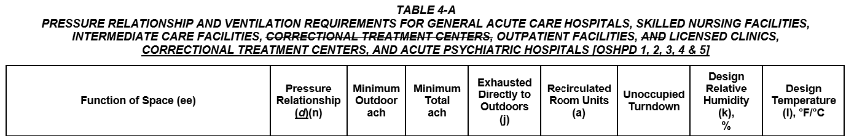
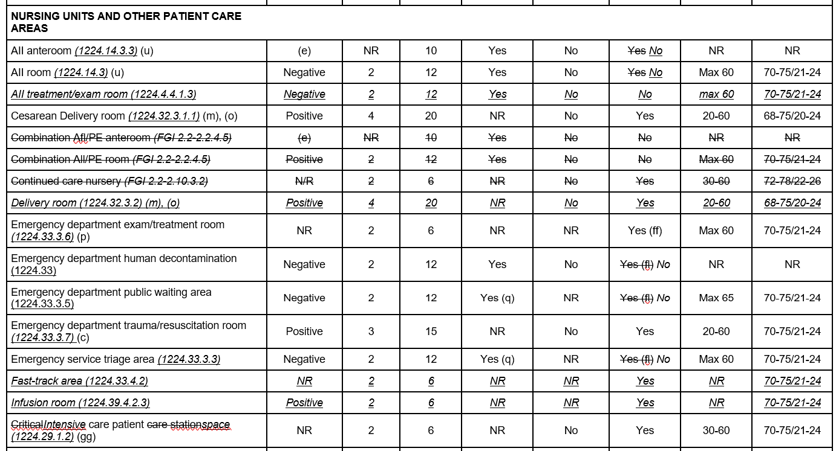
Notes:
This copy of Table 4-A All normal straight font is the ASHRAE 170 table items. All underlined items are either OSHPD amendments brought forward from the previous code cycle or new amendments.
Notable changes will be discussed today. The expressed terms and statement of reasons describing the changes are available at the California Building Standards website under the rulemaking page for the 2024 Triennial Code Adoption Cycle. The final documents can be found under the commissions meetings tab and is located under the December 17-19, 2024 meeting.
The ASHRAE 170 tables included FGI section numbers and were replaced with CBC Table numbers to assist in identifying the function of the space with the Building Code.
Room names were also revised to match the room names as used in the California Building Code.
Rooms not currently adopted under Table 4-A were shown stricken.
The unoccupied turndown column was added and some spaces were revised to match the requirements found in 407.7.
The format of the Table follows the ASHRAE 170 Table 7-1 format and the table starts with the nursing unit and patient care spaces. The prior Table 4-A was in alphabetical order. This format groups rooms by service type.

Slide 24
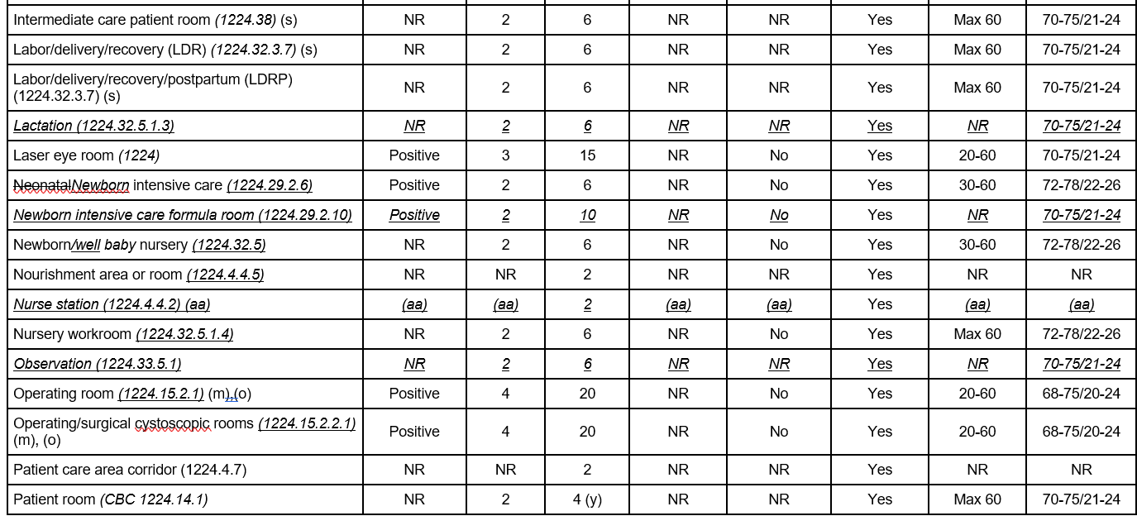
Notes:
This slide shows previous amendments brought forward.
The title for Table 4-A had minor revisions. The OSHPD Banner was added at the request of the CBSC Code Advisory Committee. The order of facility types was coordinated with the order of the OSHPD designations 1, 2, 3, 4 & 5.

Slide 25
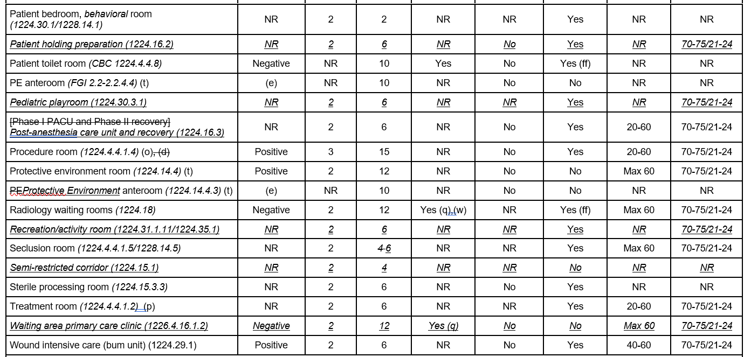
Notes:
Similar on this slide, Previous OPSHPd amendment brought forward, and room functions coordinated with CBC terminology.

Slide 26
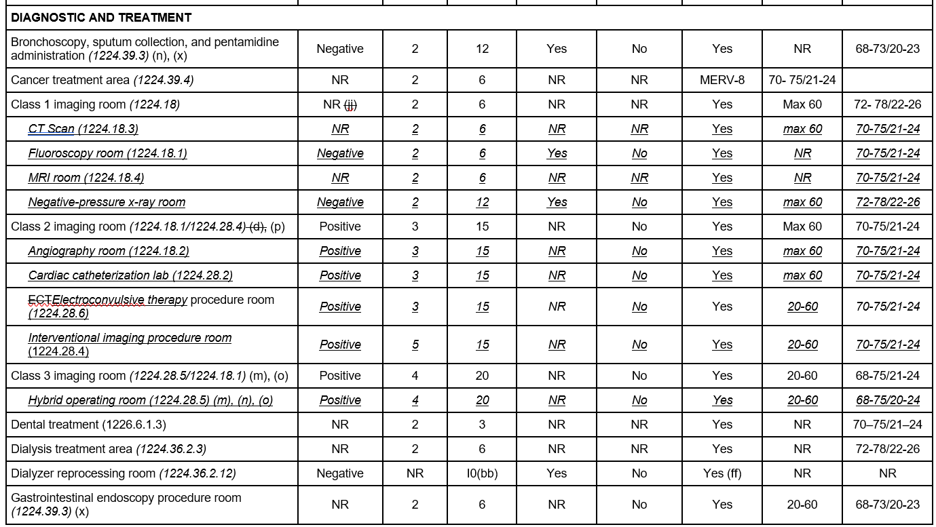
Notes:
This section of Table 4-A starts with diagnostic and treatment areas and follows the ASHRAE 170 format.
OSHPD amended rooms were added under class 1, 2 and 3 imaging. These rooms start in the specific class but could be required to be a higher class depending on the procedures done in the room. The procedures list is required to be provided in the functional program and the imaging room class will be confirmed by CDPH.
This printing has an error for cancer treatment which was corrected in the proof phase.

Slide 27
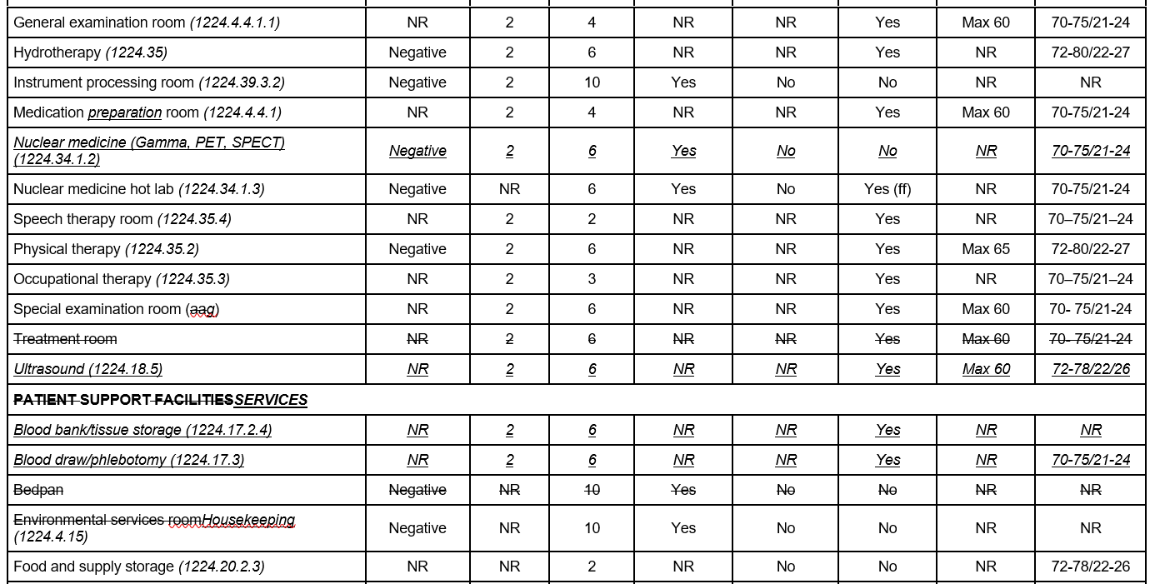
Notes:
This section continues with diagnostic and treatment spaces and is followed by support spaces. Again, the terminology is revised to be consistent with the terminology of The OSHPD Amendments in sections 1224, 1225, 1226 of the California Building Code.

Slide 28
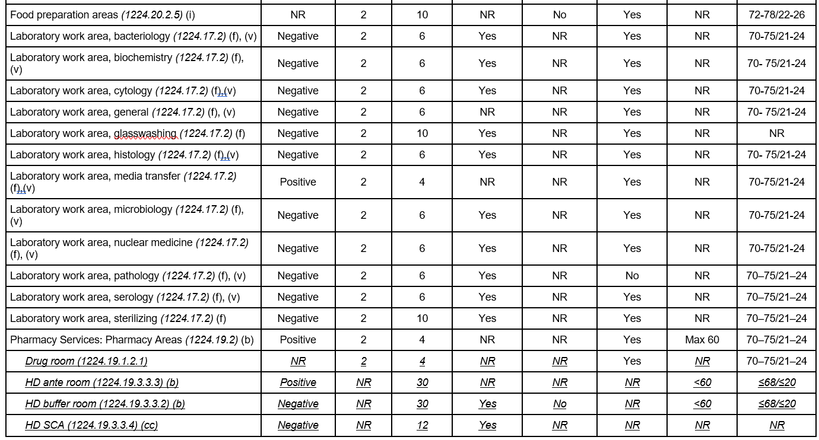
Notes:
More support services, with OSHPD amendments for Pharmacy compounding brought forward into the Table.

Slide 29
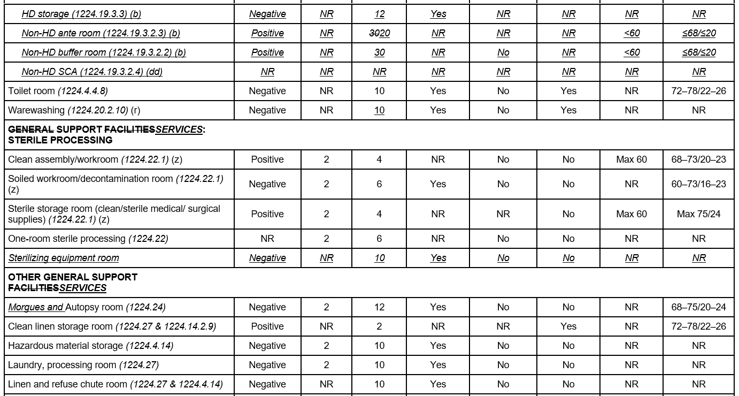
Notes:
Continuing with Pharmacy compounding. The Non-HD anteroom air change rate was revised to match USP 797. An anteroom for a Non-HD buffer room is only required to be iso 8. When the anteroom serves an HD buffer room the iso rating is required to be iso 7 and 30 air changes per hour is required.
The table continues with Support service for Sterile Processing, followed by other general support services.

Slide 30
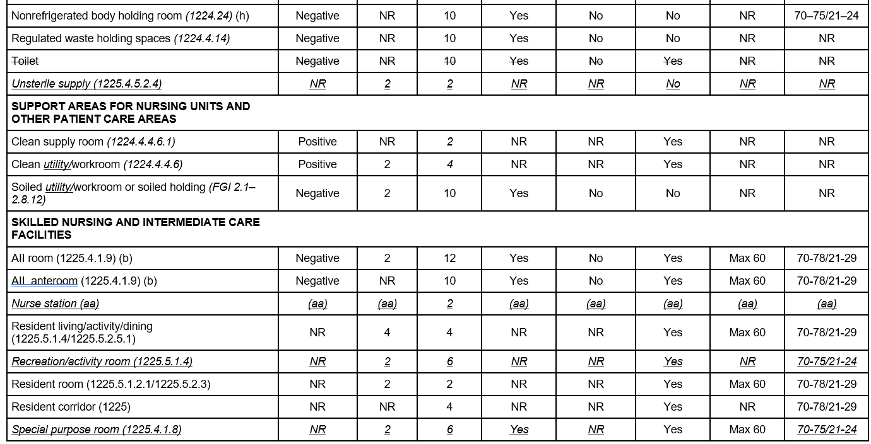
Notes:
The table continues with support areas for nursing units and then is followed by Skiled nursing and intermediate care facilities. These bring in ASHRAE 170 Table 9-1 rooms associated with SNFs.

Slide 31
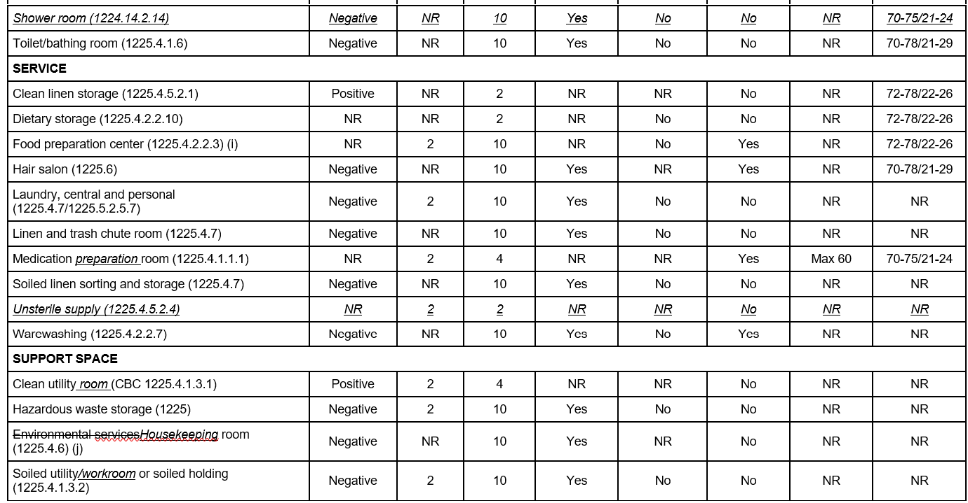
Notes:
This slide continues with skilled nursing for service and support spaces.

Slide 32
CMC Table 4-A Footnotes
Adopt ASHRAE Table 7-1 footnotes, OSHPD amendments added
Notes for Table 4-A[Only amended notes shown]:
See Section 7.2.1414.0 and 416.0 for AII ventilation requirements, including pressure relationship requirements, and Section 7.2.2 415.0 and 416.0 for PE ventilation requirements, including pressure relationship requirements.
g. Not used.(relocated from ‘aa’)Examination rooms programmed for use by patients with undiagnosed gastrointestinal symptoms, undiagnosed respiratory symptoms, or undiagnosed skin symptoms.
i. Not used. Minimum total air changes per hour (ach) shall be that required to provide proper makeup air to kitchen exhaust systems as specified in Section 511.3. Commercial cooking areas shall be designed to prevent odors from entering patient spaces.
Notes:
The footnotes were brought over form Table 7-1. OSHPD amendments brought forward without changes are not shown.
Footnote e simply revised ASHRAE 170 sections to CMC Sections.
Footnote g relocated from previous footnote ‘aa’
Footnote I was revised to coordinate with the code sections in the CMC chapter 5.

Slide 33
CMC Table 4-A Footnotes
j. In some areas with potential contamination and/or odor problems, Where the “exhaust directly to Outdoors” column is marked yes, all exhaust air shall be discharged directly to the outdoors and not recirculated to other areas. Individual circumstances may require special consideration for air exhausted to the outdoors. Recirculation room units may be provided where the column is marked yes provided air is not recirculated to other areas. To satisfy exhaust needs, constant replacement air from the outdoors is necessary when the system is in operation.
ee. Informative Note: Parenthetic notations following a space name are paragraph references to the relevant FGI Guidelines (FGI 2018a, 2018b, 2018c) in Informative Appendix ECalifornia Building Code sections from Chapter 12. These paragraph references are provided to the user to aid in the application of design requirements. Functions from 1225, 1226, 1227, or 1228 not specifically identified in he table can refer to the appropriate section from 1224.
Notes:
Footnote j was revised to match with terminology in the CMC.
Footnote ee was revised to match with the terminology of the California Building Code.

Slide 34
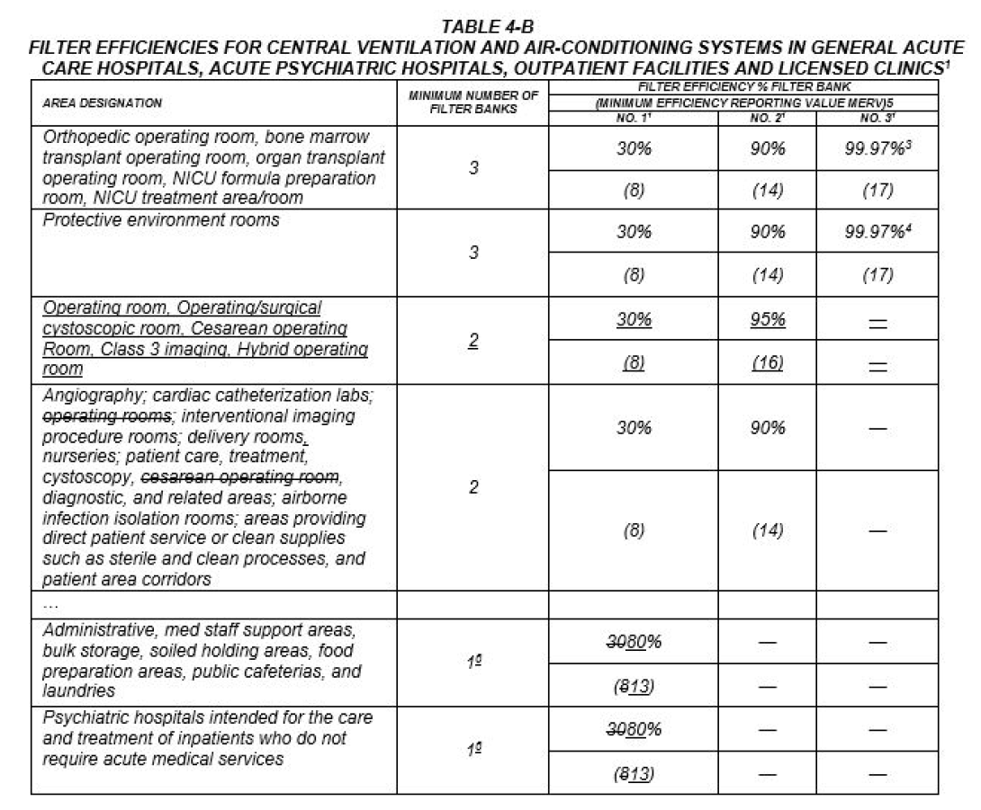

Slide 35
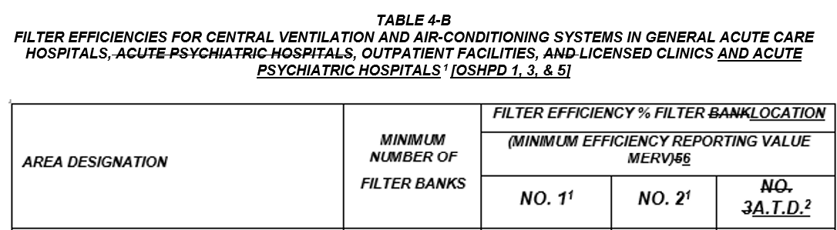
¹ Based on ASHRAE 52.2.
² Based on DOP test in accordance with MIL-STD-282 or based on ASHRAE 52.2. A.T.D. – Air terminal device serving the room or space.
³ HEPA filters are those filters that remove at least 99.97% of 0.3 micron sized particles at the rated flow in accordance with the testing methods of IEST RP- CC001.
³⁴ HEPA filters shall be located at in the air terminal device of the room served outlet or other locations when approved by the Authority Having Jurisdiction.
⁴⁵ HEPA filters shall be located in the air terminal device of the room served. HEPA filters shall be permitted to be located in the air handling unit subject to the exception in ASHRAE 170, Section 7.2.2(c). supply duct which serves the positive-pressure isolation room or rooms may serve more than one supply outlet and more than one positive-pressure isolation room. HEPA filter or a filter with minimum efficiency reporting value (MERV) of 17 installation shall be designed and equipped to permit safe removal, disposal and replacement of filters.
⁵⁶ The numbers in parentheses represent MERV rating based on ASHRAE 52.2.
⁶⁷ Additional prefilters with a minimum efficiency of MERV 8 may be used to reduce maintenance for filters.
Notes:
Footnotes revised to accommodate the changes due to the HEPA filter location requirements in ASRHAE 170-2021 edition.
Footnote 3 added HEPA filter requirement found in ASHRAE 170-2021
Footnote 4 revised for HEPA filter location
Footnote 5 revised for HEPA filter location with a note to the exceotion in ASHRAE 170, Section 7.2.2(c)

Slide 36
CHAPTER 6 DUCT SYSTEMS
603.4 Flexible Air Ducts. …
603.4.1 Length Limitation. [Not permitted for OSHPD 1, 1R, 2, 3, 4 & 5] Flexible air ducts shall be not more than 5 feet (1524 mm) in length and shall not be used in lieu of rigid elbows or fittings. Flexible air ducts shall be permitted to be used as an elbow at a terminal device.
Exception: Residential occupancies.
603.4.1.1 Flexible Ducts. [OSHPD 1, 1R, 2, 3, 4 & 5] In hospital building projects and all other health-care facilities, including clinics and correctional treatment centers, flexible ducts of not more than 10 feet (3048 mm) in length may be used to connect supply, return or exhaust-air terminal devices to rigid duct systems. Where constant volume, variable volume or mixing boxes are utilized, flexible duct of not more than 10 5 feet (30481524 mm), may be used on the inlet side for alignment. An internal impervious liner shall be provided to isolate insulation material from conditioned air. Flexible duct is not permitted in corridors where fire or smoke dampers are omitted per CBC 717.5.4 and the duct is required to be constructed of steel not less than 0.019 inch (0.483 mm) in thickness.
Notes:
OSHPD 1R removed from this requirement.
Duct length for alignment of boxes reduced to the model code length limitation.
Last sentence provided to coordinate with the building code requirement in Section 717.5.4 where dampers are omitted in the corridor, duct work in that portion of ductwork are required to be steel.

Slide 37
CHAPTER 6 DUCT SYSTEMS
605.0 Insulation of Ducts.
…
605.2 [OSHPD 1, 1R, 2, 3 (Surgical Clinics), 4 & 5] Thermal acoustical lining materials shall not be installed within ducts, terminal boxes, sound traps, and other in-duct systems serving areas such as operating, cesarean operating rooms, delivery rooms, class 3 imaging, hybrid operating rooms, post anesthesia care units, cystoscopy, cardiac catheterization labs, nurseries, intensive care units, newborn intensive care units, protective environment rooms and airborne infection isolation rooms unless filters with 90 percent average efficiency based on ASHRAE Standard 52.2 or minimum efficiency rating value (MERV) of 14 are installed downstream of the duct lining. See ASHRAE 170, section 6.9 for duct lining for non-sensitive areas or rooms.
605.3 [OSHPD 1, 1R, 2, 4 & 5] Thermal or acoustical lining materials shall not be installed within ducts which are downstream of the 99.97 percent high-efficiency particulate air (HEPA) filter or with minimum efficiency rating value (MERV) of 17 required in Section 408.2.1 for protective environment rooms.
Notes:
OSHPD 1R and 2 removed form the banner. This applies to sensitive spaces found in OSHPD 1 or 3 surgical clinics.
The list of rooms this applies to was coordinated with the room similar room types in the Building Code.
605.3 was updated to HEPA only per the national standard.

Slide 38
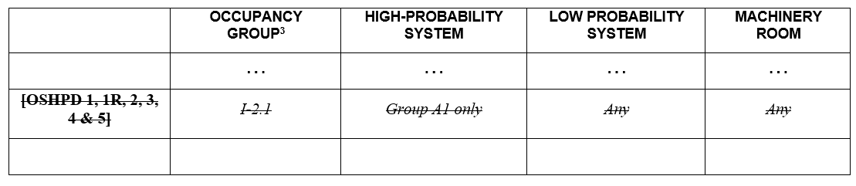
CHAPTER 11 REFRIGERATION
TABLE 1104.1
PERMISSIBLE REFRIGERATION SYSTEMS¹
Notes:
This was a holdover from the intervening cycle. The SFM removed group I02.1 occupancies from the Building Code.

Slide 39
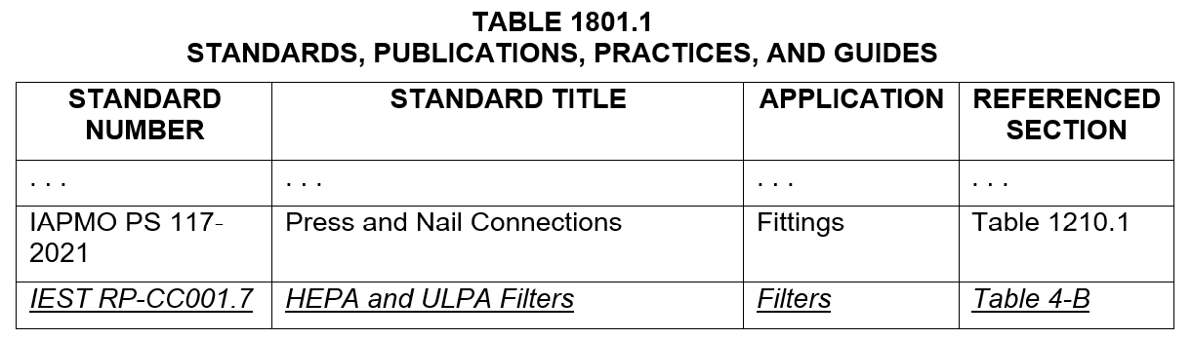
CHAPTER 18 REFERENCED STANDARDS
Notes:
The referenced standard quoted in Table 4-B for HEPA filtration was added to the Table.

Slide 40
2025 California Plumbing Code
Part 5

Slide 41
CHAPTER 2 DEFINITIONS
210.0 – H –
…
Handwashing Fixture [OSHPD 1, 2, 3, 4, 5 & 56]. Handwashing fixtures consist of faucet, trim and lavatory as described:
Faucets and Trim
…
c. Faucets shall not be equipped with an aerator but may be equipped with a non-aerating laminar flow device. The flow rate for handwashing fixtures shall not be less than 1.0 (3.79 L) gallons per minute.
d. Faucets shall be equipped with gooseneck spouts. A gooseneck spout shall be deck or fixture-mounted so the discharge point of the spout return is at least 10 inches (25.4 mm) above the bottom of the basin. The water shall not flow directly from the spout into the drain. The gooseneck spout shall have a 180(+/-510) degree return with a constant radius and the outlet pointing vertically down.
Notes:
This change in item ‘c’ is a minimum flow to prevent legionella growth. Public handwashing fixture in waiting rooms still must comply with Title 20 for .5gpm.
Item d revises the tolerance on the 180 degree spout to reflect models on the market.

Slide 42
CHAPTER 2 DEFINITIONS
221.0 – S –
...
Scrub Sink [OSHPD 1, 2, 3, 4 & 5]. Is a sink used to wash and scrub the hands and arms during the septic preparation for surgery and equipped with a supply spout and controls as required for a handwashing fixture. The scrub sink shall be trimmed with foot, knee or electronic sensor controls that do not involve contact with the upper extremities. Sensor operated fixtures shall be capable of functioning during loss of normal power. Single-lever wrist blades shall not be permitted except for the temperature pre-set valve.
Notes:
The Scrub sink controls will no longer reference the handwashing fixture section. Operation with upper extremities is required.
Wrist blades for temperature control is permitted for presetting temperature (FGI).

Slide 43
CHAPTER 3 GENERAL REGULATIONS
319.0 [Not permitted for OSHPD 1, 2, 3, 4 & 5] Medical Gas and Vacuum Systems.
319.1 General. Such piping shall be in accordance with the requirements of Chapter 13. The Authority Having Jurisdiction shall require evidence of the competency of the installers and verifiers.
Notes:
Removing OSHPD amendment for general code requirement pointing to Chapter 13.

Slide 44
CHAPTER 4 PLUMBING FIXTURES AND FIXTURE FITTINGS
422.0 Minimum Number of Required Fixtures
...
422.3 Fixture Requirements for Special Occupancy. …
422.3.1 [OSHPD 1, 2, 3, 4, & 5 & 6] Separate toilet facilities shall be provided for the use of patients, staff personnel and visitors.
Exceptions:
(1) fFor Primary Care Clinics Only: Wwhere a facility contains no more than three examination and/or treatment rooms, the patient toilet shall be permitted to serve waiting areas.
(2) For public waiting areas with an occupant load of 10 or less, one toilet facility, designed for use by no more than one person at a time, shall be permitted for use by both sexes.
Notes:
Adding a second exception for public waiting rooms serving 10 or less.
This will help clarify requirements for small clinics and remote waiting areas

Slide 45
CHAPTER 6 WATER SUPPLY AND DISTRIBUTION
604.0 Materials
604.1 Pipe, Tube, and Fittings. Pipe, tube, fittings, solvent cement, thread sealants, solders, and flux used in potable water systems intended to supply drinking water shall comply with NSF 61. Where pipe fittings and valves are made from copper alloys containing more than 15 percent zinc by weight and are used in plastic piping systems, they shall be resistant to dezincification and stress corrosion cracking in compliance with NSF 14.
Materials used in the water supply system, except valves and similar devices, shall be of a like material, except where otherwise approved by the Authority Having Jurisdiction.
Materials for building water piping and building supply piping shall comply with the applicable standards referenced in Table 604.1.
Exception: [OSHPD 1, 2, 3, 4 & 5] Use of CPVC is not permitted for potable water applications. under authority of the Office of Statewide Health Planning and Development.
Notes:
Clarifying this is for potable water piping of the domestic water provisions for the scope of chapter 6 and not all water. Sometimes this amendment is confused with all piping in the building.
OSHPD removed from amendment, banner identifies adopting agency.

Slide 46
CHAPTER 6 WATER SUPPLY AND DISTRIBUTION
609.0 Installation, Testing, Unions, and Location.
…
609.10 Disinfection of Potable Water System. New or repaired potable water systems shall be disinfected prior to use where required by the Authority Having Jurisdiction. [OSHPD 1, 1R, 2, 3, 4 & 5] Prior to utilization of newly constructed or altered potable water piping systems, all affected potable water piping shall be disinfected using procedures prescribed in California Plumbing Code Sections 609.10(1) through 609.10(45). The method to be followed shall be that prescribed by the Health Authority or, in case no method is prescribed by it, the following:
(5) [OSHPD 1, 1R, 2, 3, 4& 5] Disinfection shall be completed no more than three weeks before whole or partial beneficial occupancy.
(a) Where occupancy is delayed two weeks from disinfection, flushing of all fixtures shall again be completed.
(b) Where occupancy is delayed four weeks after disinfection, disinfection and flushing shall again be completed.
Notes:
Bringing in timing of disinfection from ASHRAE 188/G12. If disinfection is done too early, the water can age and cause issues.

Slide 47
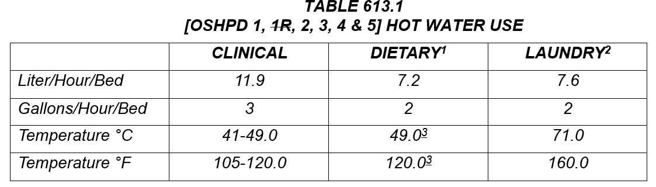
¹ Rinse water temperature at automatic dishwashing equipment and potsinks shall be 180°F(82°C). Rinse water temperature at warewasher or potsinks shall be 180ºF (82ºC) unless a chemical disinfection is provided.
Exception: The rinse water supply to pot rinse sinks may be deleted if a method of chemical disinfection using a three-compartment sink is proposed.
² The required temperature of 160°F (71°C) in the laundry is that measure in the washing machine and shall be supplied so that the temperature may be maintained over the entire wash and rinse period.
Exception: A lower water temperature of 140°F (60°C) may be utilized, provided linens are subsequently passed through a tumbler dryer at 180°F (82°C) or a flatwork ironer at 300°F (149°C).
³ Dietary hot water temperature shall meet minimum temperature requirements at the point of use per the health authority.
Notes:
The footnotes were revised to coordinate with he retail food code requirements.

Slide 48
CHAPTER 6 WATER SUPPLY AND DISTRIBUTION
613.2 At least two pieces of hot-water-heating equipment shall be provided to supply hot water for dishwashing and minimum patient services such as handwashing and bathing. The arrangement of water-heating equipment shall be based on the capacity and capability of the equipment to provide the required hot water during periods of breakdown or maintenance of any one water heater. Booster heaters for 125°F to 180°F (52°C to 82°C) water are acceptable as a second piece of equipment for dishwashing. Where storage tanks are separate from the water heater, at least two independent storage tanks shall be provided. Storage water heaters and hot-water storage tanks shall be maintained at 140°F (60°C) or above.
Notes:
The minimum temperature is to keep the water temperature out of the legionella growth range. ASHRAE Guideline 12, CPC Appendix N.

Slide 49
CHAPTER 6 WATER SUPPLY AND DISTRIBUTION
613.6 Hot-water distribution system serving patient care areas shall be under constant mechanical recirculation to provide continuous hot water at each hot water outlet. Hot water recirculation piping shall return the recirculation loop back through the hot water source. Non-recirculated fixture branch piping shall not exceed 2510 feet (7.62 3.05 meters) in length. Dead-end piping (risers with no flow, branches with no fixture) shall not be installed. In renovation projects, dead-end piping shall be removed in the area of renovation. Empty risers, mains, and branches installed for future use shall be permitted.
…
613.9 Hot water distribution shall include test ports and valved openings for flushing of portions of the system in accordance with the facilities water management program as defined in Appendix N.
Notes:
The hot water return piping can be as low as 105F which is in the legionella growth range, returning the water through the 140F tank will reduce legionella.
Hot waer branch piping is revised to 10ft - FGI

Slide 50
CHAPTER 6 WATER SUPPLY AND DISTRIBUTION
614.0 [OSHPD 1, 2, 3, 4 & 5] Dialysis Water-Distribution Systems.
614.1 [OSHPD 1, 2, 3, 4 & 5] Dialysis water feedlines shall be CPVC (chlorinated polyvinyl chloride), PVC (polyvinyl chloride), glass, stainless steel, PEX, PVDF (polyvinylidene fluoride), or other material deemed acceptable by ANSI/AAMI/ISO RD 62 23500-2 and sized to provide a minimum velocity of 1.5 feet per second (0.46 m/s). The piping shall be a singleloop system with or without recirculation. Branches to dialysis machines shall be 1∕4 inch (6.4 mm) inside dimension and take off from the bottom of the main feedline. Branch lines may be PFA (perfluoroalkoxy).
…
614.7 Water treatment equipment and water used for dialysis treatment shall meet the latest edition of ANSI/American Association of Medical Instrumentations(AAMI)/ISO RD62ANSI/AAMI/ISO 23500-2 and 23500-3, Preparation And Quality Management Of Fluids For Haemodialysis And Related Therapies—Part 2: Water Treatment Equipment For Haemodialysis Applications And Related Therapies and Part 3: Water For Haemodialysis And Related Therapies
Notes:
OSHPD Banner moved to 614.0.
Reivised AAMI standard RD 62 to current 23500-2 and -3 standard.

Slide 51
CHAPTER 6 WATER SUPPLY AND DISTRIBUTION
615.4.2 616.2 The emergency supply of water shall be provided at adequate pressure using gravity, pressure tanks, or booster pumps. Pumps used for this purpose shall be provided with electrical power from the on-site emergency power supply system.
616.3 Storage tank connections and circulation shall be designed to limit water stagnation and temperature stratification. Supplemental disinfection and circulation shall be provided where the disinfection levels of the public water supply are not adequate to maintain minimum levels of disinfectant for water quality consistent with the facility’s water management program.
Notes:
615.4.2 revised to 616.2
New section 616.3 added to provide performance requirement for storage tanks. Large water storage tanks are not recommended except for emergency storage due to water quality issues.
This new section will acknowledge the design requirements to provide a clean water storage.

Slide 52
CHAPTER 7 SANITARY DRAINAGE
727.0 [OSHPD 1] Emergency Sanitary Drainage.
727.1 For new acute care hospital buildings submitted after the effective date of this code, the hospital shall have an onsite holding tank[s] to store sewage and liquid waste sufficient to operate essential hospital utilities and equipment in the acute care hospital building, to support 72 hours of continuing operation in the event of an emergency. Any general acute care hospital in operation after January 1, 2030 shall have an on-site holding tank[s] to store sewage and liquid waste sufficient to operate essential hospital utilities and equipment in the acute care hospital buildings on the campus with an SPC-3, SPC-4, SPC-4D, or SPC-5 rating, to support 72 hours of continuing operation in the event of an emergency. The emergency waste holding capacity shall be based on the Water Conservation/Water Rationing Plan required in Section 615.4.1. See also California Building Code, Part 2, Section 1617A.1.40.
Notes:
SPC-4D added to coordinate with California Administrative Code and Building Code requirements.

Slide 53
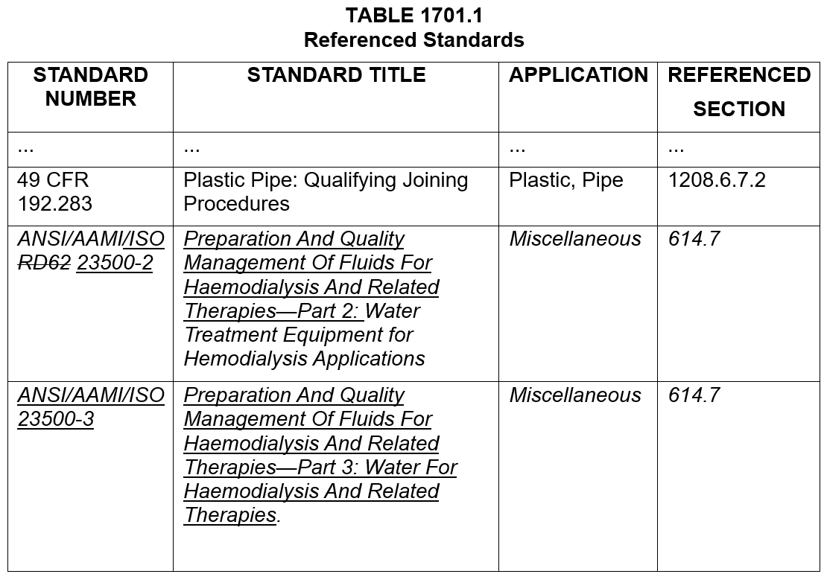
CHAPTER 17 REFERENCED STANDARDS
Notes:
Referenced standards added AAMI 23500-2, -3 standards for dialysis.

