Slide 1
Thank you for joining the CBO Application Webinar.
We will be starting in:
00
01
59
58
57
56
55
54
53
52
51
50
49
48
47
46
45
44
43
42
41
40
39
38
37
36
35
34
33
32
31
30
29
28
27
26
25
24
23
22
21
20
19
18
17
16
15
14
13
12
11
10
09
08
07
06
05
04
03
02
01
00
59
58
57
56
55
54
53
52
51
50
49
48
47
46
45
44
43
42
41
40
39
38
37
36
35
34
33
32
31
30
29
28
27
26
25
24
23
22
21
20
19
18
17
16
15
14
13
12
11
10
09
08
07
06
05
04
03
02
01
00
:

Slide 2
Community Based Organization Behavioral Health Workforce: Online Application Information Guide
September 14, 2023
Notes:
VERSION 12.8.2022

Slide 3
Agenda
Topic | Presenter
Purpose of the CBO Central Application | Michael Andrijich, Grants Management Unit Manager
Data Security Obligation for CBOs | Michael Andrijich, Grants Management Unit Manager
Application Data Uses | Andre Haynes, Research Data Analyst
Secure File Transfer Process | Andre Haynes, Research Data Analyst
CBO Awardee Reporting | Michael Andrijich, Grants Management Unit Manager
Online Application (Step-by-Step) | Andre Haynes, Research Data Analyst
Questions & Answers | Christopher Roina, Communication Analyst
Closing Remarks | Michael Andrijich, Grants Management Unit Manager

Slide 4
HCAI and CBO Central Application: Overview & Purpose
Michael Andrijich, Grants Management Unit Manager

Slide 5
Our Mission
HCAI expands equitable access to quality, affordable health care for all Californians through resilient facilities, actionable information, and the health workforce each community needs.

Slide 6
HCAI Overview
Established in 1978 as OSHPD – the Office of Statewide Health Planning and Development to ensure healthcare accessibility within California
Transitioned to the Department of Health Care Access and Information (HCAI) in 2021 to reflect a growing portfolio and a more descriptive name

Slide 7
Health Workforce Development
Support and increase a health workforce that:
Serves medically underserved areas
Represents the California it serves through racial and language diversity
Serves Medi-Cal members
Offer programs that provide financial support for:
Organizations expanding educational capacity
Individuals to pursue health careers (scholarship and loan repayment)
Organizations to build the workforce pipeline

Slide 8
Purpose of the CBO Central Application
The California Department of Health Care Access and Information (HCAI) hosts this application on behalf of recipients of the Community-Based Organization (CBO) Behavioral Health Workforce Grant Program.
HCAI will collect applications and send them to the employer. Grantees must use the application information to make scholarship, stipend, and loan repayment award decisions.

Slide 9
Timeline
Event​ | Date​
Application Available​ | September 18, 2023, 3:00 p.m.​
Application Submission Deadline | November 13, 2023
2023-24 CBO applicant report sent to CBO via Secure File Transfer (SFT) process (date – 20 business days after application closes) | December 13, 2023
CBO notifies HCAI of awardees | December 29, 2023
2023-24 Annual Report Opens | July 1, 2024
2023-24 Annual Report Closes | July 31, 2024

Slide 10
Data Security Obligation for CBOs
Michael Andrijich, Grants Management Unit Manager

Slide 11
Grantee Responsibilities
Community Based Organizations (Grantee) is obligated to protect unauthorized disclosure of any Personal, Sensitive and Confidential Information.
Please refer to Exhibit A - Privacy and Information Security- in your Grant Agreement for further details about:
Definitions
Grantee Responsibilities
Safeguards
Breach and Recovery
HCAI Information Security Office Contact (ISO)

Slide 12
Application Data Uses
Andre Haynes, Research Data Analyst

Slide 13
Shared Information
HCAI will share the following individual information with the Grantee:
Contact Information
Employment Experience and Career Goals
Educational History
Current or Planned Enrollment
Languages

Slide 14
Demographic Data Disclosure
HCAI will not share individual applicant demographic information with the Grantee or any third party
HCAI will remove all demographic data and payment processing information from the information shared with the employer
HCAI will only disclose demographic information collected in response to application questions in aggregate reporting
Collection of demographic data will help HCAI evaluate the effectiveness in recruiting and retaining a diverse and culturally competent workforce

Slide 15
Demographic Information
HCAI will collect the following demographic and license information which will be used for program evaluation and reporting purposes.
Race
Ethnicity
Date of Birth
Sexual Orientation
Gender Identity

Slide 16
Past Awardee Verification
HCAI will ask the awardee (employee) to provide the following information to verify if the applicant is a past recipient of HCAI awards*:
Date of Birth
Driver’s License Number
Other applicable license, registration, or certificate numbers including NPI
*HCAI will NOT share information about the applicant's previous HCAI awards with the Grantee (Employer)

Slide 17
Secure File Transfer Process (SFT)
Andre Haynes, Research Data Analyst

Slide 18
SFT Process
HCAI will download the employee application (survey) data file to verify and validate the applicant data.
HCAI will transfer the applicants’ data to the Grantee and provide two encrypted emails:
The first encrypted email is a secured link to the SFT portal.
The second encrypted email is a password to access the SFT portal.
CBO (employer) can download the applicant data and make award decisions.

Slide 19
CBO Awardee Reporting
Michael Andrijich, Grants Management Unit Manager

Slide 20
CBO (Grantee) Reporting Requirements
Once CBO makes their award selection, the CBO's will send their award selections for loan repayment, scholarships, and stipends via a Secure File Transfer (SFT) process.
For recruitment and retention awards, HCAI will send an Excel spreadsheet for CBOs to indicate those awards back to HCAI.
CBOs will be required to report on all award types annually.
Payments will be made in arrears annually upon completion of the annual report.

Slide 21
Online Application
Andre Haynes, Research Data Analyst

Slide 22
About this section
This section will show you, step-by-step, on how to complete the Community Based Organization Behavioral Health Workforce online application
Please note that the application link is sent directly to the Grantee (Employer) for distribution to their employees

Slide 23
Begin the Application
Scroll to the bottom of the home page to begin the application.
Select to continue to the next page to complete the application.

Slide 24
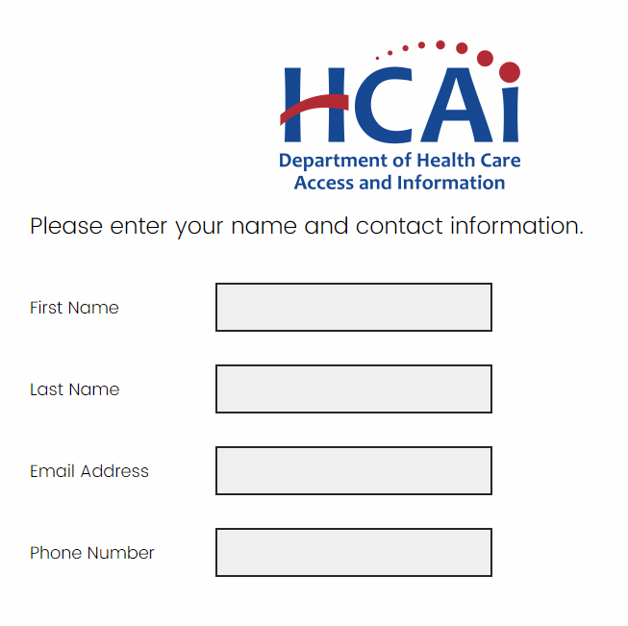
Contact Info
Please provide contact information
Click to continue

Slide 25
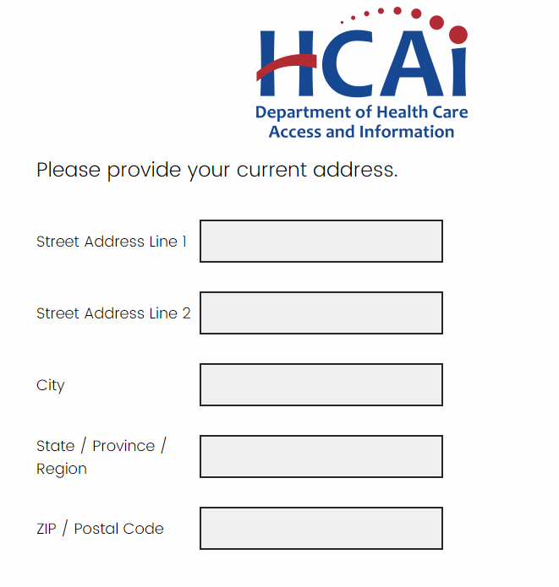
Address Information
Please provide current address
Click to continue

Slide 26
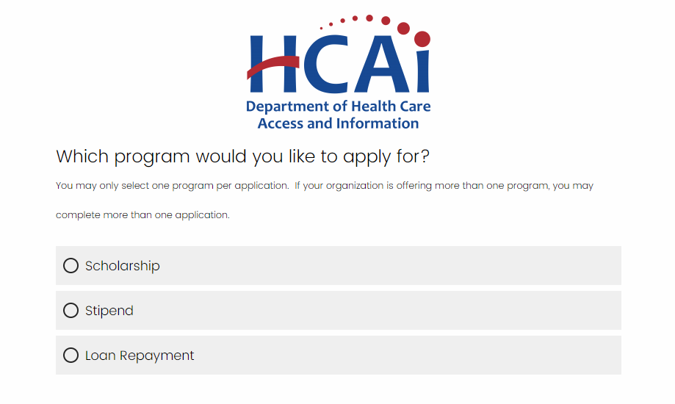
Grantee Offered Programs
Select the program you would like to apply for
Only programs offered to the Grantee will be displayed
Click to continue
*If your employer is offering more than one type of award and you believe you may be eligible for more than one type of award, you may apply for multiple awards.

Slide 27
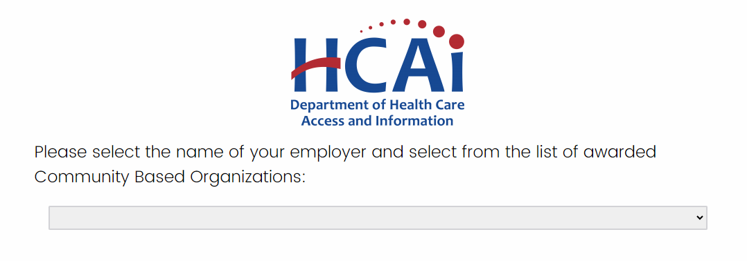
Employer Name
Please select the Community Based Organization (employer name)
Click the down arrow to display CBO organization list
Select organization
Click to continue

Slide 28
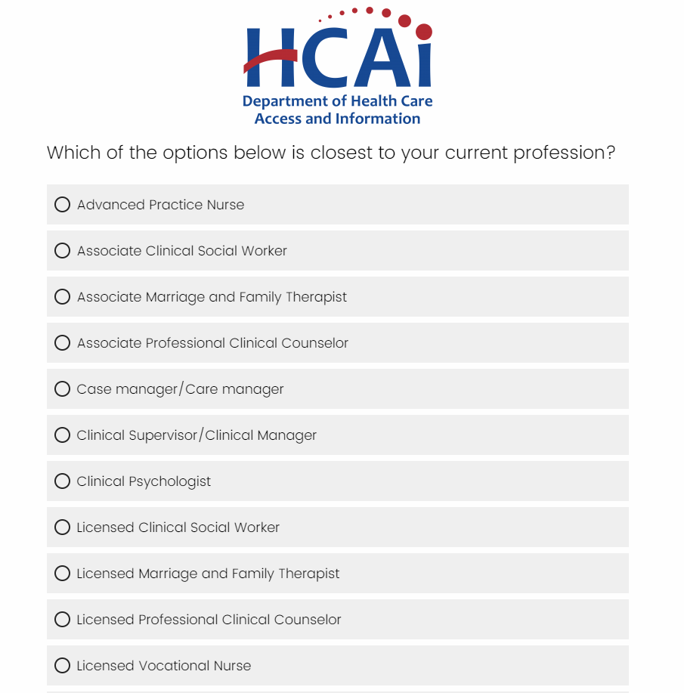
Current Profession (1/2)
Please select current profession from the listed options*
Click to continue
*List of all profession options are not displayed

Slide 29
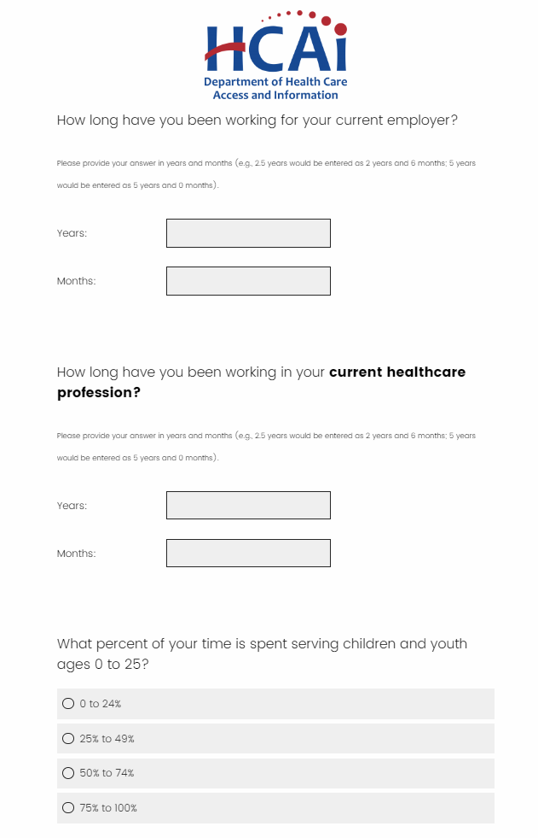
Current Profession (2/2)
Please enter length of time, years & months working in current profession
Select percent of time serving children and youth
Click to continue

Slide 30
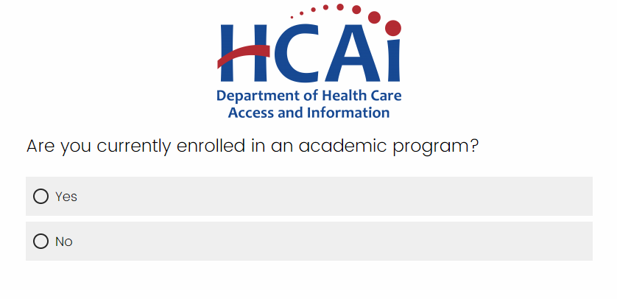
Academic Information
Please select if you are enrolled in an academic program and if you have an undergraduate degree*
Click to continue
*Additional education questions will appear with a “yes” answer

Slide 31
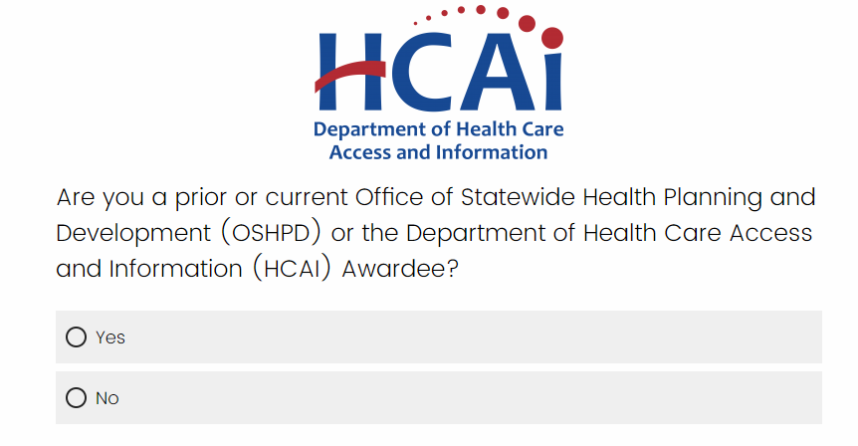
Awardee History
Please select if you are a past or current OSHPD or HCAI awardee*
Click to continue
*Additional questions will appear with a “yes” answer

Slide 32
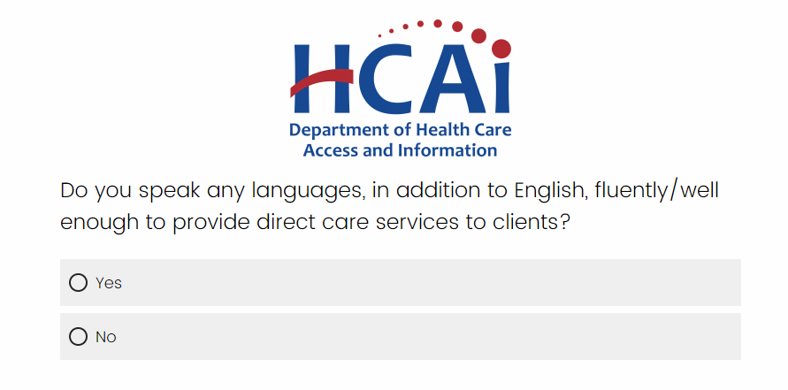
Language(s) Spoken
Please select if you speak any languages in addition to English
Click to continue

Slide 33
Additional Languages Spoken
Please select additional languages fluently spoken*
Click to continue
*List of all languages spoken options are not displayed

Slide 34
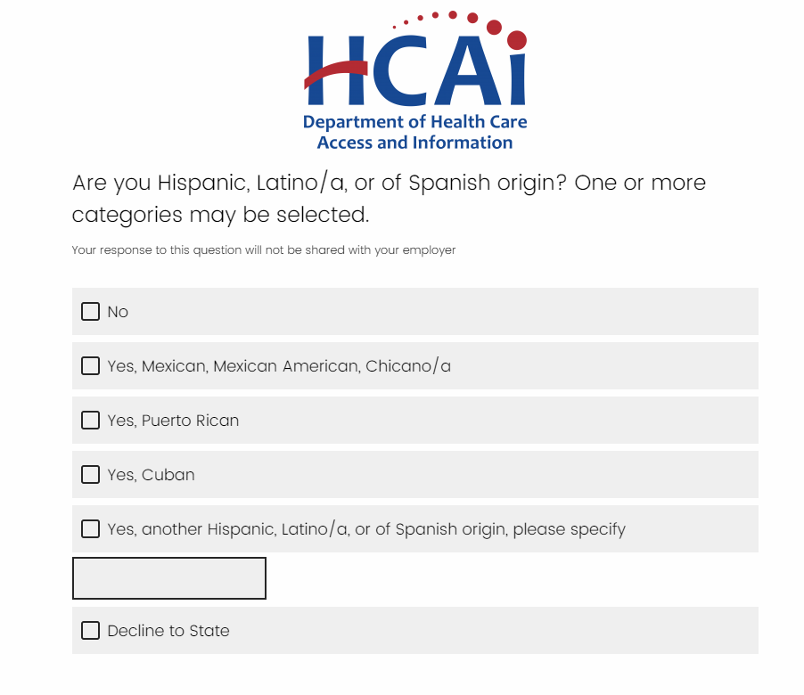
Demographic Questions (1/3)
The demographic questions* will consist of:
Race
Ethnicity
Date of Birth
Gender Identity
Sexual Orientation
Please make your selections and click to proceed through this section
*HCAI will not share individual applicant demographic information with the Grantee or any third party.

Slide 35
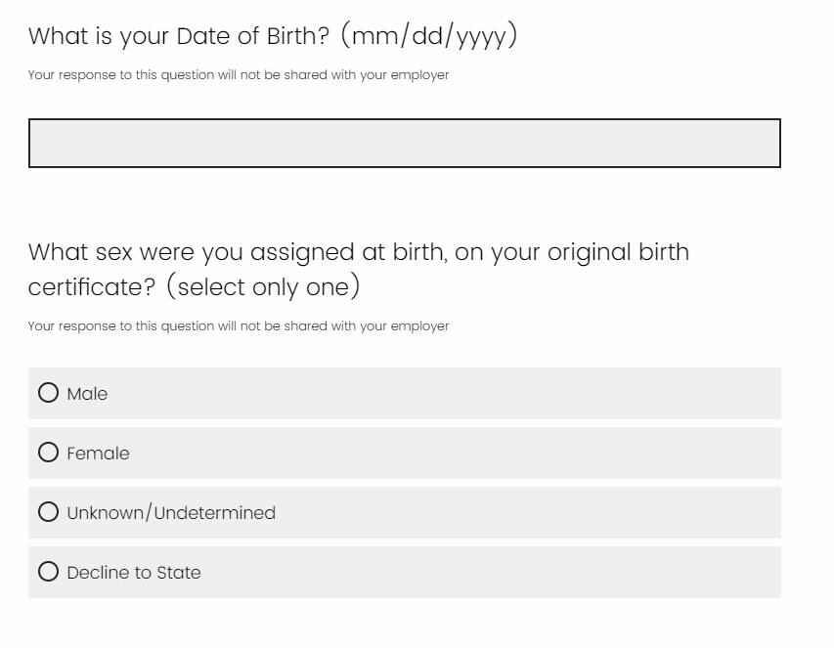
Demographic Questions (2/3)
*List of all Race options are not displayed

Slide 36
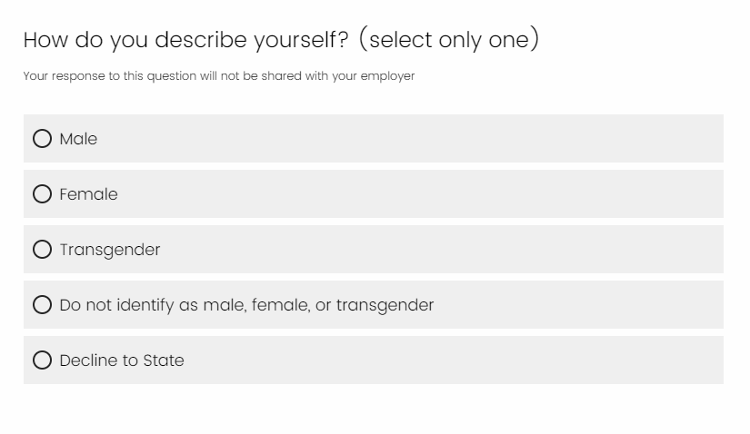
Demographic Questions (3/3)

Slide 37
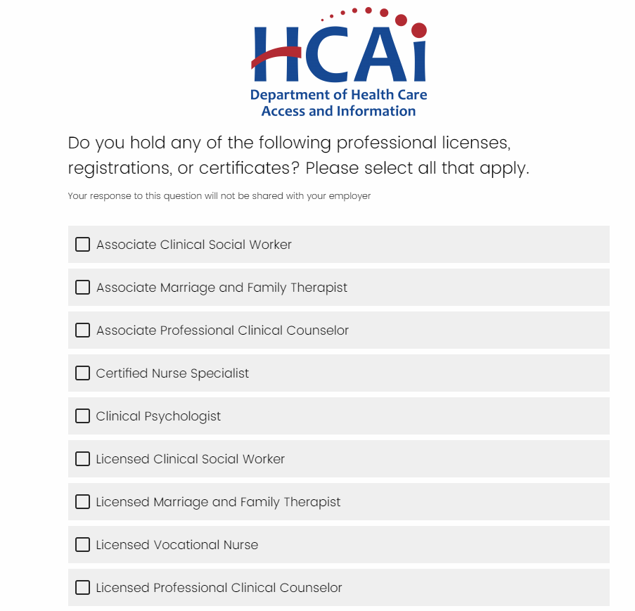
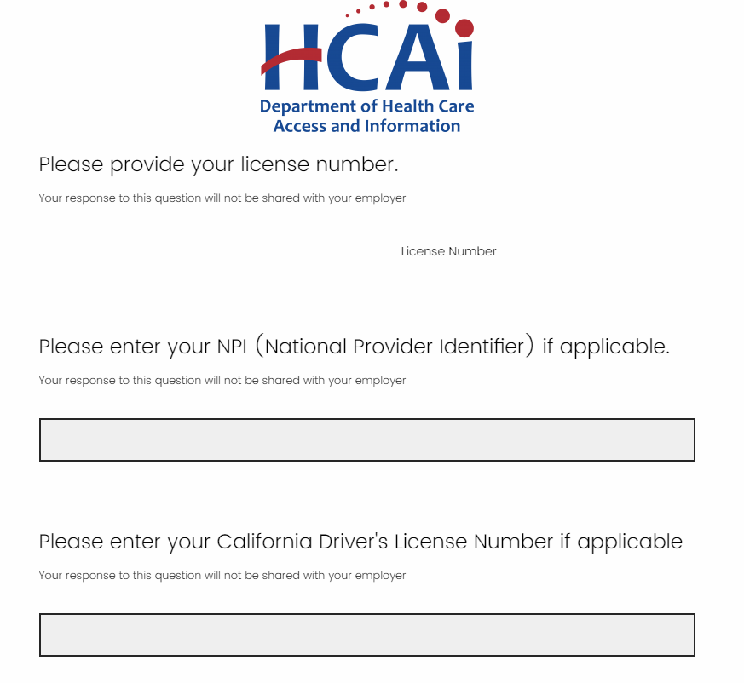
License Information
Please provide profession* license held (if applicable)
Click to continue
*List of all profession options are not displayed

Slide 38
Future Reference Contact
Provide contact information of an individual who knows how to reach the applicant if they move or change email address
Click to continue

Slide 39
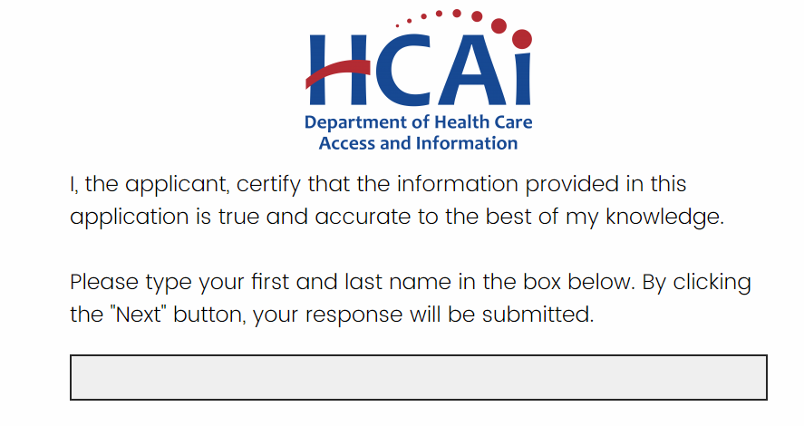
Signature Page Contact
To submit the application, please enter your first and last name
Click to complete the application

Slide 40
Signature Page Contact

Slide 41
Questions & Answers
Christopher Roina, Communication Analyst

Slide 42
Closing Remarks
Michael Andrijich, Grants Management Unit Manager

Slide 43
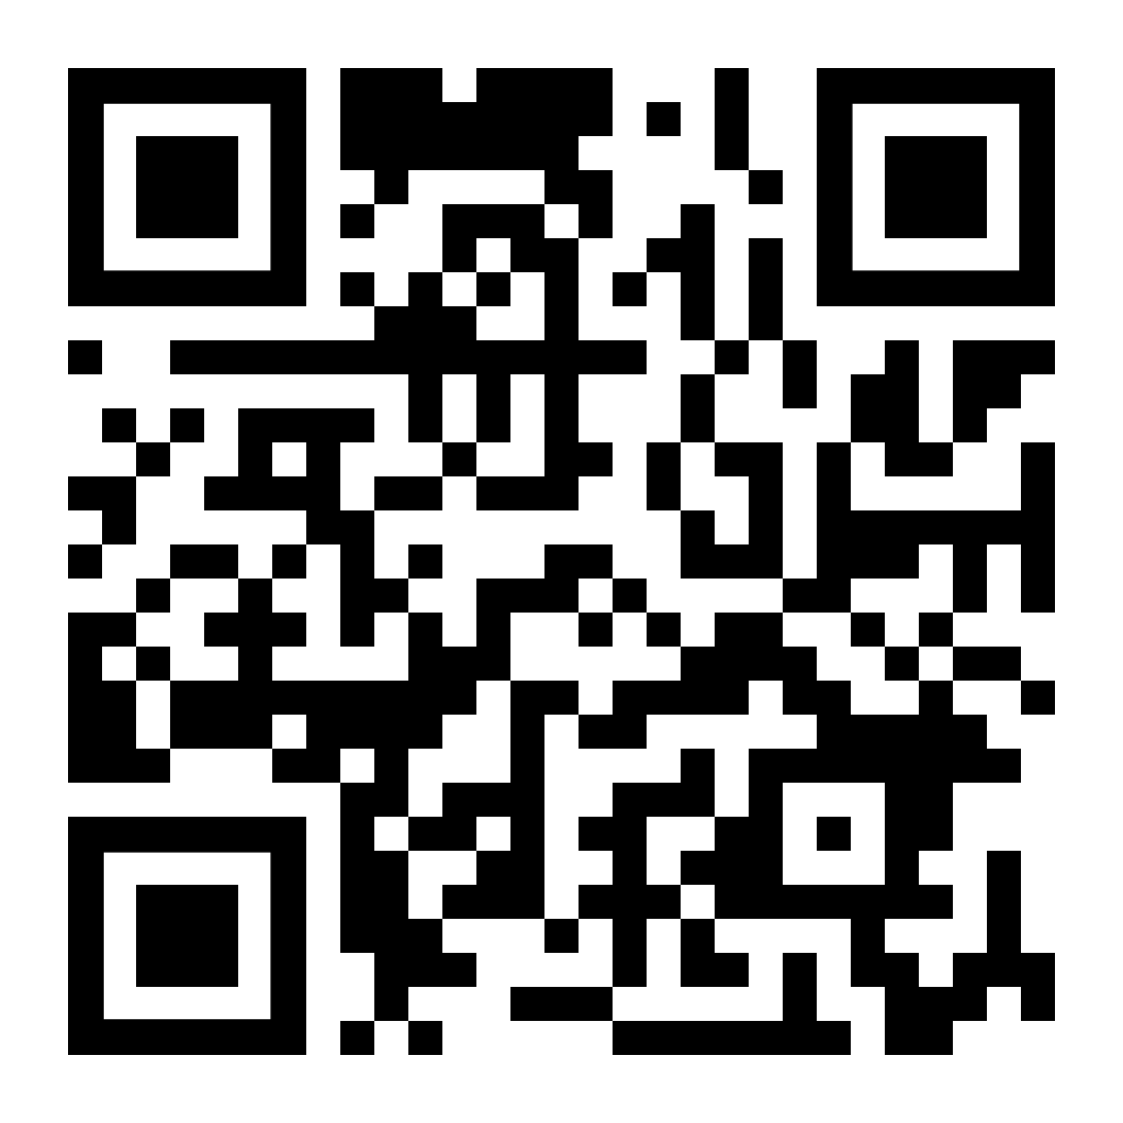
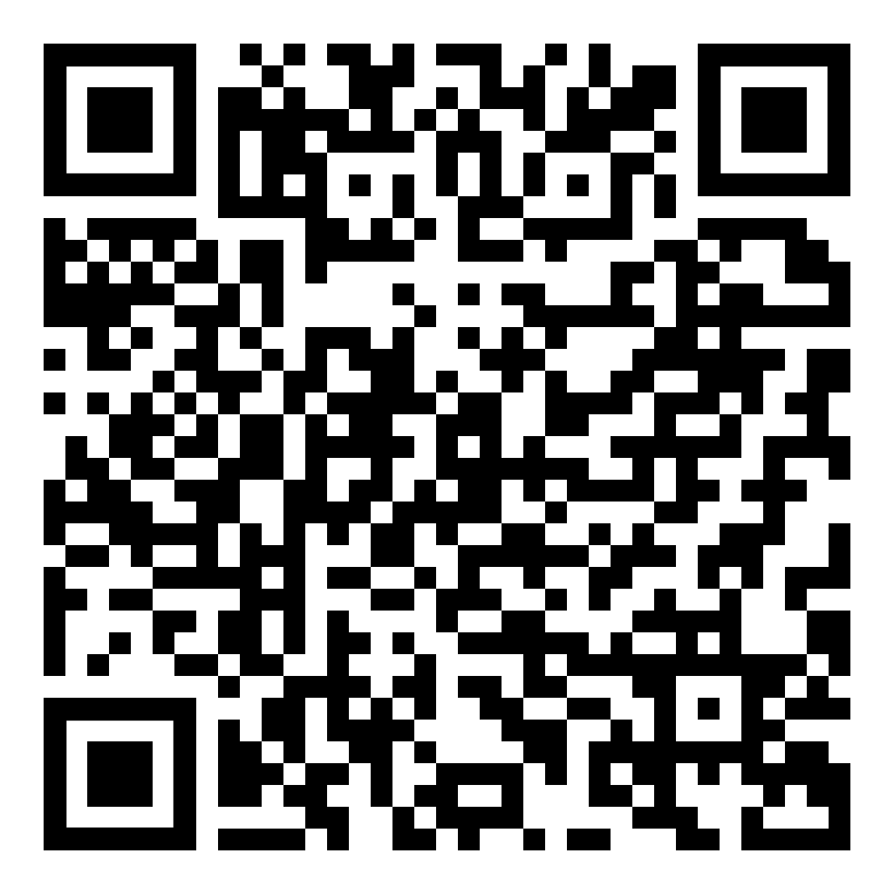
Follow Us!
Website
Twitter
Facebook
YouTube
in
LinkedIn
#WeAreHCAI #HCAI #HealthWorkforce #HealthFacilities #HealthInformation

Slide 44
Sign Up to our Newsletter!
https://hcai.ca.gov/mailing-list/
Contact Us!
Phone (916) 326-3700
#WeAreHCAI #HCAI #HealthWorkforce #HealthFacilities #HealthInformation

Slide 45
Thank You! For further questions, please email bhprograms@hcai.ca.gov
Notes:
Michele? Caryn?

