Slide 1
Introduction to PGP Encryption & Secure File Transfer Protocol (SFTP)
Reliable data.
Informed decisions.
Strategic advantage.
February 5, 2024

Slide 2
Welcome & Onpoint Introductions
Dawn Hamlin, Senior Operations Analyst
Nicole Jakubowski, Operations Analyst
Jacob Kemer, Cloud Support Engineer

Slide 3
Agenda
Submitting files to the Healthcare Payments Database (HPD) Program
Upload files manually in Onpoint CDM (Claims Data Manager)
Submit files via SFTP
Demonstrations of PGP (Pretty Good Privacy) encryption and SFTP access
Next steps, resources, and support to establish connectivity with Onpoint
Questions?
Implementation and training timeline reminders

Slide 4
Submitting Files to the HPD Program
Dawn Hamlin, Senior Operations Analyst

Slide 5
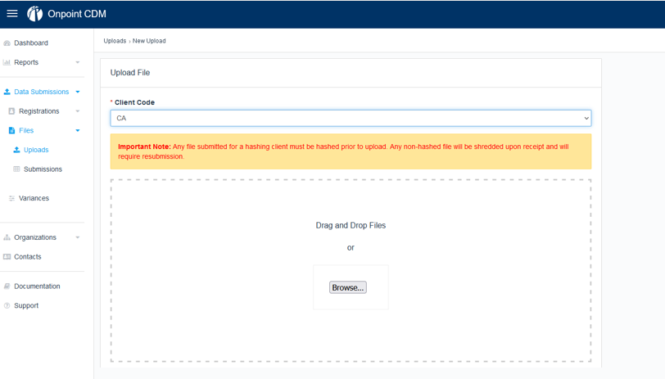
Option #1 – Upload Files Manually in Onpoint CDM

Slide 6
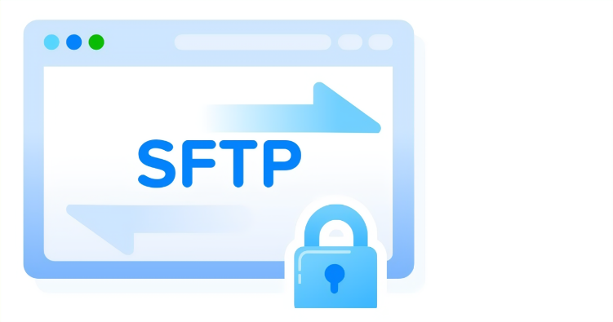
Option #2 – Submit Files via SFTP
Secure File Transfer Protocol (SFTP)
Provides an encrypted channel for secure file transmissions between a client and a host system

Slide 7
Required for Both Options – PGP Encryption
PGP uses a key pair – consisting of one public key and one private key – to encrypt sensitive data to allow for secure exchange between two parties
Generate raw
file
Sign with Data Supplier’s private key
Encrypt with Onpoint’s public key
Signed & encrypted
file
SFTP
with
PGP
PR
PU
Data Supplier
Onpoint

Slide 8
PGP Encryption & SFTP – The Basics
Onpoint uses PGP encryption to protect files (at rest) and to confirm the sender
As part of PGP encryption and SFTP data transfer, submitters generate two sets of key pairs:
A PGP key pair, used for encrypting your data
An SSH (Secure Shell) key pair, used for SFTP account authentication
Both PGP and SSH key pairs have a public and a private key
Private keys should never be shared and should be backed up
Public keys are transferable and are shared with Onpoint
Different organizations have different security requirements; contact your IT team to confirm your organization’s firewall access

Slide 9
Demonstrations of PGP Encryption & SFTP Access
Jacob Kemer, Cloud Support Engineer

Slide 10
Demonstrations
Demonstration #1 – PGP encryption
Generate PGP key
Encrypt file(s)
Demonstration #2 – SFTP access
Generate an SSH key
Log in to SFTP account
Transfer file(s) via SFTP

Slide 11
Demonstration #1 – PGP Encryption

Slide 12
Demonstration #2 – SFTP Access

Slide 13
FAQs – Submitting via SFTP
"Why do I still see my submission in my SFTP account after file transfer?"
Files “live” within your SFTP account for 30 days but can be deleted or resubmitted at your discretion
After 30 days, files are archived locally within your SFTP account for 150 days but cannot be updated or deleted without permission from Onpoint’s IT department
To update or delete archived files, please send a request to: hpd-support@onpointhealthdata.org
"How do I know whether my file transferred successfully?"
SFTP submission and file progress are traceable within Onpoint CDM
If a file fails during the transmission process, your team is informed via an automated email

Slide 14
Next Steps, Resources, & Support
Dawn Hamlin, Senior Operations Analyst

Slide 15
Next Steps for Establishing SFTP Connectivity
Onpoint has created a user guide for PGP setup and SFTP connectivity that details all aspects of the process, including…
Step-by-step directions regarding PGP and SSH key generation
An overview of establishing SFTP connectivity with Onpoint
Guidelines for file signing, encryption, and decryption
Onpoint will send a follow-up email with SFTP registration form and user guide
Communicate with your IT department to coordinate SFTP connectivity efforts
Please note: While submitters are encouraged to prepare PGP and SSH key pairs and initiate internal requests for PGP encryption and SFTP connectivity, Onpoint cannot complete SFTP requests until the submitter has completed registration.

Slide 16
Questions?
Technical questions:
hpd-support@onpointhealthdata.org
Regulatory questions:
hpd@hcai.ca.gov

Slide 17
Implementation & Training Timeline Reminders

Slide 18
Implementation & Training Timeline
Date | Details
January 2, 2024 | Opening of submitter registration for HPD plans
January 4, 2024 | Webinar: HPD Submitter Registration Training
January 11, 2024 | Webinar: Overview of HPD Dental Data & CDL v3.0.1
January 31, 2024 | Health plan/insurer (non-dental) registration deadline
February 5, 2024 | Webinar: Introduction to PGP Encryption & Secure File Transfer Protocol (SFTP)
February 22, 2024 | Webinar: Overview & Demo of Onpoint CDM
February 29, 2024 | Health submitter (non-dental) registration deadline
March 1, 2024 | Deadline for existing HPD submitters to submit files for first reporting period (January 2024), formatted using CDL™ v3.0.1 specifications
March 4, 2024 | Webinar: Overview of Onpoint CDM Variance Request Process & Data Submission Best Practices
March 29, 2024 | Dental plan and submitter registration deadline
July 31, 2024 | Deadline for successful submission of historical dental test data, formatted using CDL™ v3.0.1 specifications
Ongoing | One-on-one meetings between individual dental submitters and Onpoint staff as needed

Slide 19
Thank you.

