Slide 1
California State Loan Repayment Program (SLRP)
Program Overview August 18, 2022

Slide 2
About SLRP
SLRP assists with the repayment of educational loans for healthcare professionals who commit to serving in federally designated Health Professional Shortage Areas (HPSAs) or at a Federally Qualified Health Center (FQHC).
SLRP is administered at the state level by HCAI.

Slide 3
SLRP Application Release Dates
Application: Opened July 15, 2022
Application Early Submission: September 1, 2022
Application Closes: September 15, 2022, at 3:00 p.m.

Slide 4
New Changes to SLRP
There is no match requirement from eligible SLRP practice sites.
SLRP applicants will submit an Employment Verification Form (EVF) when applying for SLRP.
Future SLRP awardees will download and complete the EVF, have their EVF signed by their site representative, and upload into the SLRP eApp every six months.
SLRP will review all submitted applications received by 09/01/2022, and provide feedback on any documentation needed. Applications submitted after 09/01/2022 will be considered final, and will be reviewed when the cycle closes on 09/15/2022.

Slide 5
To apply and be considered for a SLRP award, a clinician must:
Be a US citizen (US born or naturalized)
Possess a current, unrestricted license to practice in California
Be free of judgments arising from federal debt (e.g., no liens)
Have no other existing commitment or service obligation to any other entity
Not be in breach of a health professional service obligation to federal, state, or local governments
Be current on all child support payments
Be currently employed or have accepted employment at a SLRP approved practice site
Commit to a two-year full-time or two-year half-time service agreement
SLRP Clinician Requirements

Slide 6
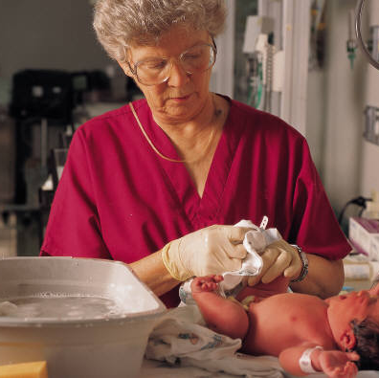
Eligible Professions
Medical Doctors and Doctors of Osteopathic Medicine (MD & DO)
Family Medicine, OB/GYN, Geriatrics, General Pediatrics, Psychiatry, General Internal Medicine
Primary Care Physician Assistant (PA)
Primary Care Nurse Practitioner (NP)
Pharmacist (PharmD)
Certified Nurse Midwife (CNM)
Psychiatric Nurse Specialist (PNS)
Health Service Psychologist (HSP)
Licensed Clinical Social Worker (LCSW)
Licensed Professional Counselor (LPC)
Licensed Marriage and Family Therapist (LMFT)
Doctors of Dental Surgery (DDS) and Doctors of Dental Medicine (DMD)
Registered Dental Hygienists (RDH)
Substance Use Disorder (SUD) Counselor

Slide 7
Work Requirements
Full-Time
Grantee must work a minimum of 40 hours per week.
Grantee must work a minimum of 32 hours per week in direct patient care.
OB/GYNs, pediatric dentists, geriatric servicers, and mental and behavioral healthcare providers must work a minimum of 21 hours per week in direct patient care.
No more than eight (8) hours per week can be spent in an administrative capacity or spent performing practice-related activities, such as precepting and teaching.
Grantee may not count time spent “on-call” toward these work requirements.
Half-Time
Grantee must work a minimum of 20 hours per week.
Grantee must work a minimum of 16 hours per week in direct patient care.
OB/GYNs, pediatric dentists, geriatric servicers, and mental and behavioral healthcare providers must work a minimum of 11 hours per week in direct patient care.
No more than four (4) hours per week can be spent in an administrative capacity or be spent performing practice-related activities, such as precepting and teaching.
Grantee may not count time spent “on-call” toward these work requirements.

Slide 8
SLRP Award Amounts
Full-time Awards
Half-time Awards
2-Year Commitment
Up to $50,000
1st Year (Optional Extension)
Up to $20,000
2nd Year (Optional Extension)
Up to $20,000
3rd Year (Optional Extension)
Up to $10,000
4th Year (Optional Extension)
Up to $10,000
2-Year Commitment
Up to $25,000
1st Year (Optional Extension)
Up to $10,000
2nd Year (Optional Extension)
Up to $10,000
3rd Year (Optional Extension)
Up to $5,000
4th Year (Optional Extension)
Up to $5,000

Slide 9
Eligible Debt
Government and commercial loans obtained from qualifying lenders for undergraduate and graduate health profession degrees.
Qualified lenders are those subject to examination and supervision by an agency of the United States, or the state in which the institution has their place of business.
Notes:
If it’s consolidated we ask for details of consolidation bec spouse’s loans or credit card loans are not eligible

Slide 10
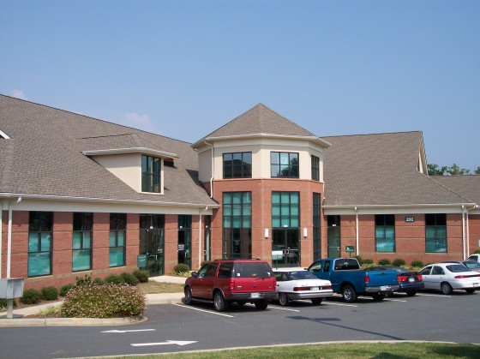
SLRP Site Eligibility Requirements
Public or Private not-for-profit entity
Located in a federally designated HPSA or FQHC
Provide outpatient care (primary medical, mental, and dental health)
Pay providers’ prevailing salaries and agree not to reduce salaries due to SLRP support
Provide services on a free or reduced fee
schedule basis to individuals at or below
200% of the federal poverty level

Slide 11
Grant Agreement Deliverables
Every six months*, the Grantee shall submit an Employment Verification Form (EVF) through the eApp to verify their hours worked and days missed.
The Grantee shall submit documentation of payments made towards eligible student debt for the SLRP award amount within 30 days of the agreement end date.
*HCAI reserves the right to increase or decrease the number of EVFs required during the obligation period.

Slide 12
Communication Requirements
Grantees must email HCAI within the specified timeframes for the following reasons:
a. Immediately:
If you are no longer employed by the approved practice site.
b. Within 30 calendar days if you:
Change to your name, mailing address, phone number, e-mail address or lending institution.
Will be changing your current practice site for a new practice site.
Begin a leave of absence for medical or personal reasons.

Slide 13
Communication Requirements (cont’d.)
c. Within 60 calendar days if you:
Begin parental/adoption leave.
Are requesting to switch from full-time to half-time status.
NOTE: A Grantee is allowed to be away from the SLRP approved practice site for no more than 35 workdays per service year; therefore, a Grantee’s obligation end date will be extended for each day of absence over the allowable 35 workdays.

Slide 14
SLRP Breach
HCAI reserves the right to recover the following amounts for Grantee’s failure to perform the obligations set forth in the Agreement:
For failure to start or complete Grantee’s service obligation, HCAI shall recover all the following pursuant to 42 U.S.C. § 254o(c):
The total of the amounts paid by HCAI to, or on behalf of, the Grantee for loan repayments for any period of obligated service not served; and
An amount equal to the number of months of obligated service not completed by: (i) the Full-Time Grantee multiplied by $7,500.00; or (ii) the Half-Time Grantee multiplied by $3,750.00. (Continuation Service Grantees shall be liable based on Full-Time or Half-Time Grantee status at the time of the breach); and
Interest on the above amounts at the maximum legal prevailing rate from the date of the breach. Interest is calculated at the rate utilized by the State Treasurer from the date of the breach; and
The amount HCAI is entitled to recover under this section shall be no less than $31,000.00 plus interest, even if the breach formula from above results in a lower amount due.

Slide 15
SLRP Breach (cont’d.)
For a material breach of this agreement not having to do with the start or completion of Grantee’s period of obligated service, HCAI shall recover no less than $31,000.00 plus interest from Grantee (calculated at the rate utilized by the State Treasurer from the date funds were sent to Grantee). In addition, if HCAI files a civil action to recover sums per this section, HCAI shall be entitled to recover reasonable attorneys’ fees, costs, and expenses directly related to such collection actions.
Any amount HCAI is entitled to recover from the Grantee for breach of this agreement shall be paid within one year of the date HCAI determines that the Grantee is in breach of this Agreement.
Per Government Code 16580-16586, HCAI has statutory authority to collect on any outstanding debts. HCAI may attempt to collect from the Franchise Tax Board or any Medi-Cal offsets. HCAI may contact the Employment Development Department, the Board of Equalization, and/or a collection agency to obtain repayment of the funds owed.

Slide 16
For More Information
State Loan Repayment Program (SLRP):
https://hcai.ca.gov/wp-content/uploads/2022/07/2022-23-SLRP-Grant-Guide.pdf
Department of Health Care Access and Information (HCAI):
https://www.hcai.ca.gov
Program Contacts:
SLRP Inbox:
SLRP@hcai.ca.gov

